Slide 1


Slide 2

Please silence cell phones

Slide 3


Slide 4
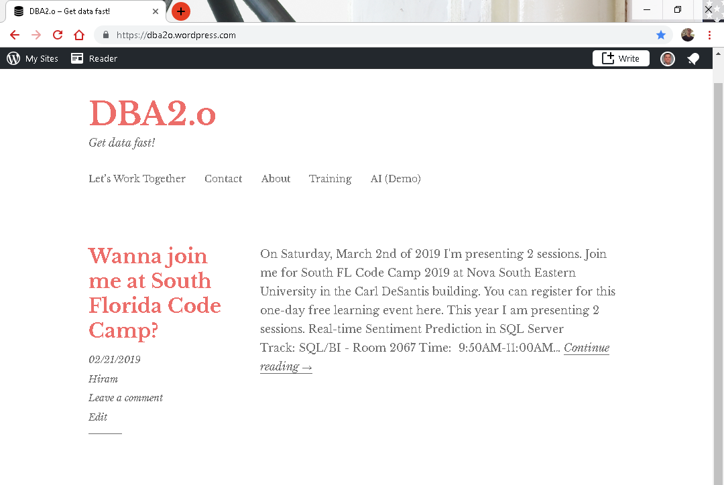

Slide 5
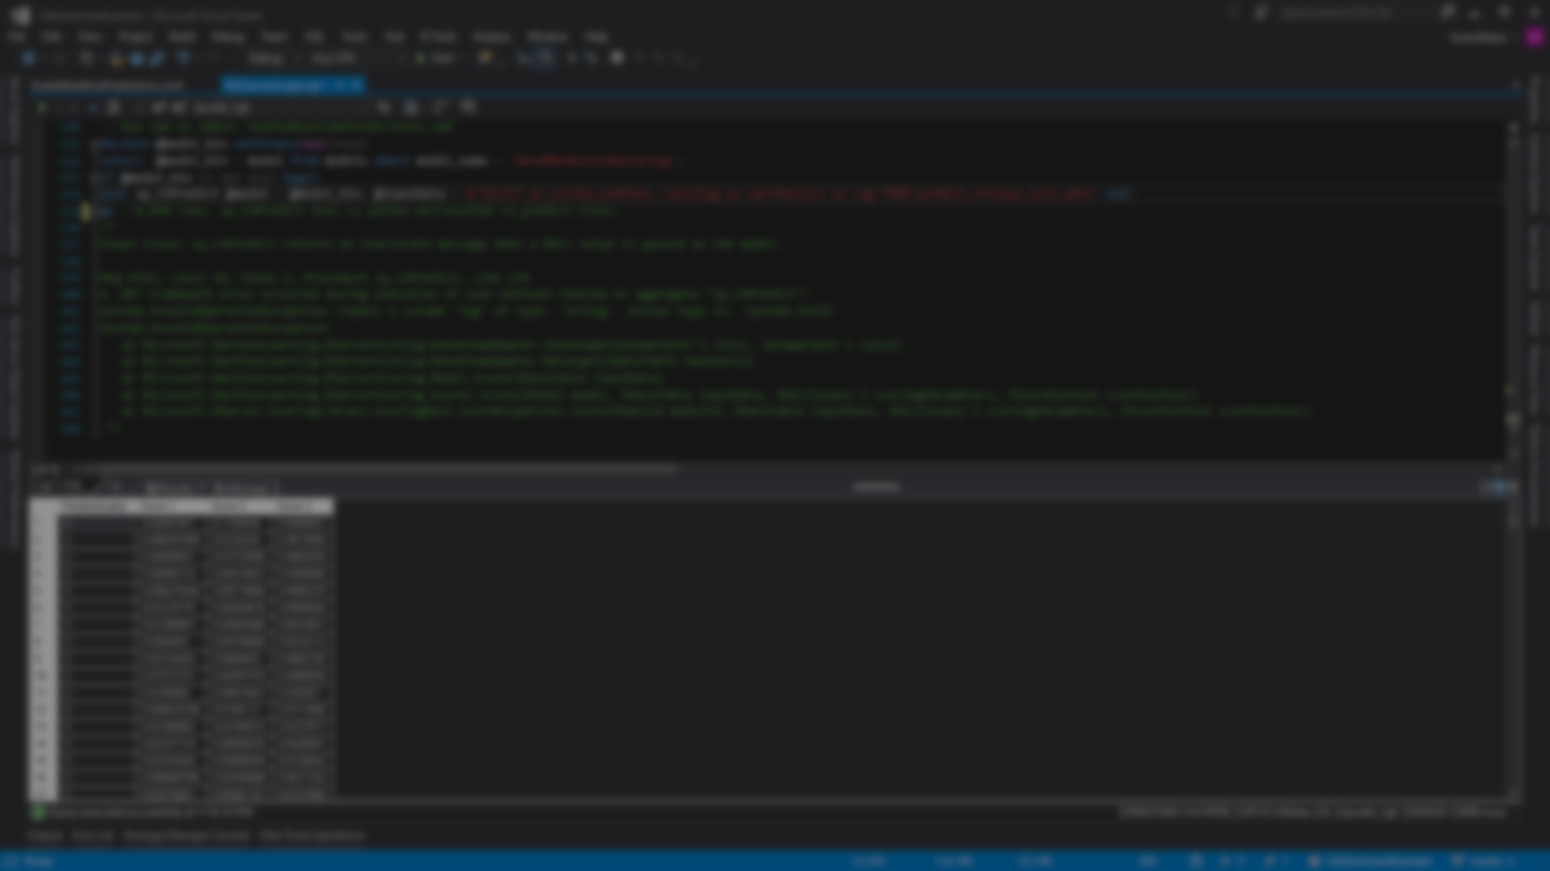
Session evaluations
This is the link:
bit.ly/pbi18
Your feedback is very important.
Submit your feedback by the end of this presentation.

Slide 6



BIO
Father
Principal DB Architect
Power BI since 2016
SQL Server since 1999
Developer since 1995
USCG Auxiliary Staff Officer
Microsoft Certified Professional
Power BI Certified
Hiram Fleitas
Instructor
FUN
Construction & Family
/HiramFleitas
/hfleitas
@HiramFleitas
hiram@fleitasarts.com
HiramFleitas
fleitasarts.com

Slide 7
Schedule (times are approximate and will be fluid with the class)
Morning
09:00 AM – 11:45 AM – Advanced Data Modeling
Afternoon
11:45 AM – 1:00 PM – Power BI Administration

Slide 8
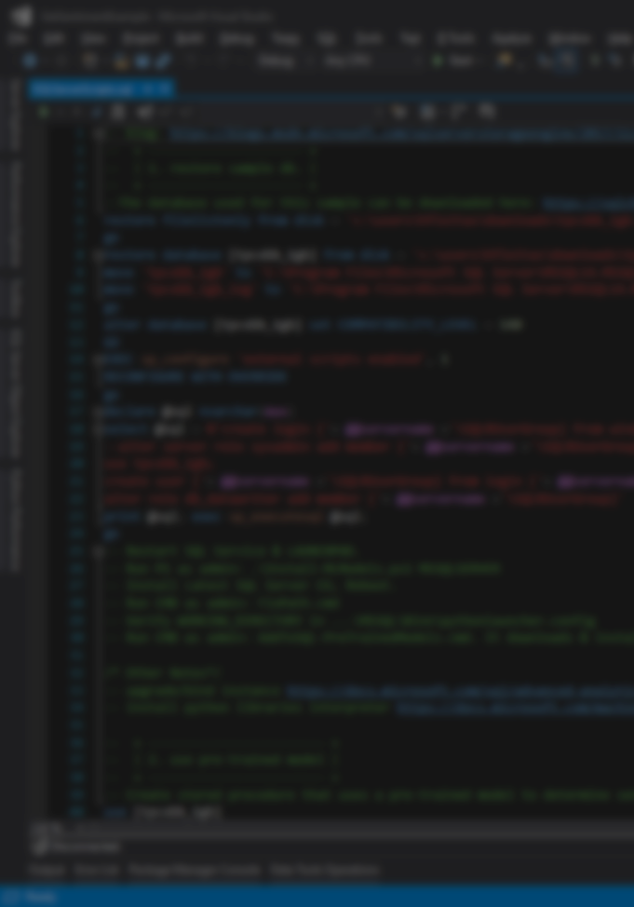
Agenda
Filtering (20min)
Cross-Filtering and Time Intelligence (20min)
Many to Many with DAX (15min)
Creating a Bridge Table (20min)
Role Playing Tables with DAX (20min)
Role Playing Tables without DAX (20min)
Mismatched Granularities (30min)
Weighted Allocation (20min)
Data Refresh Overview (20min)
Scheduling Data Refresh (20min)
Implementing Row Level Security (20min)
Implementing Dynamic Security (15min)

Slide 9
Agenda
Power BI Embedded (20min)
Key Influencers (20min)
Automated-ML (20min)
New Features Announcements (30min)
Q&A + Resources (30min)

Slide 10

Advanced Data Modeling
Filtering
In previous courses we show you how to build a relationship in the data model, but we really don’t go into detail why we build the relationship the way that we do and some of the available options. So we’re going to talk about Filtering now and we’re going to get into Cross-Filtering as well. Because Cross-Filtering is going to give us support for Many to Many relationships.
Notes:
In previous courses we show you how to build a relationship in the data model, but we really don’t go into detail why we build the relationship the way that we do and some of the available options. So we’re going to talk about Filtering now and we’re going to get into Cross-Filtering as well. Because Cross-Filtering is going to give us support for Many to Many relationships.

Slide 11
Single Filtering
Products
Sales
Customers
ProdID | Name | Price
101 | Bike | 250
102 | Socks | 10
103 | Shoes | 120
104 | Helmet | 150
105 | Gloves | 45
CustID | ProdID | Amt | QTY
3 | 101 | 250 | 1
3 | 102 | 20 | 2
1 | 105 | 45 | 1
2 | 105 | 45 | 1
2 | 104 | 150 | 1
3 | 104 | 150 | 1
4 | 101 | 250 | 1
CustID | Name
1 | Christina
2 | Ocean
3 | Skylar
4 | Brent
5 | Regis
Filtering
Automatically occurs from the single side of the relationship.
Notes:
Because of the relationship product filtering sum totals change.

Slide 12
Many to Many relationships
Customers
Products
Customer 1 – Buys Milk & Bread
Customer 2 – Buys Milk & Coffee
Customer 3 – Buys Sugar
Milk – Customers 1, 2, 4, 5
Bread – Customers 1, 4, 6, 7
Question
How many customers have purchased each product?
Notes:
This is when you have 2 tables and they have many to many relationship. You can’t build a relationship between 2 tables that have a many to many relationship. You need a Bridge Table.

Slide 13
Cross Filtering
Products
Sales
Customers
ProdID | Name | Price
101 | Bike | 250
102 | Socks | 10
103 | Shoes | 120
104 | Helmet | 150
105 | Gloves | 45
CustID | ProdID | Amt | QTY
3 | 101 | 250 | 1
3 | 102 | 20 | 2
1 | 105 | 45 | 1
2 | 105 | 45 | 1
2 | 104 | 150 | 1
3 | 104 | 150 | 1
4 | 101 | 250 | 1
CustID | Name
1 | Christina
2 | Ocean
3 | Skylar
4 | Brent
5 | Regis
Filtering
Automatically occurs from the single side of the relationship.
Notes:
Because of the current state of this data model its going to count all records in the customer table for product ID 101 Bikes and say the count of customers is 5, which is incorrect cause it should be 2 but it can’t filter the customer table. This is confusing if you don’t come from an IT or BI background, or perhaps its not advanced for you. But what we do is Turn on Cross Filtering and the Transactional table (Sales) is going to be able to filter the Customers table based on CustID.

Slide 14
Cross Filtering
DEMO 1
In this demo, we take a look at when we transition from a single sided relationship to a cross-sided relationship.
Notes:
In this demo, we take a look at when we transition from a single sided relationship to a cross-sided relationship.

Slide 15

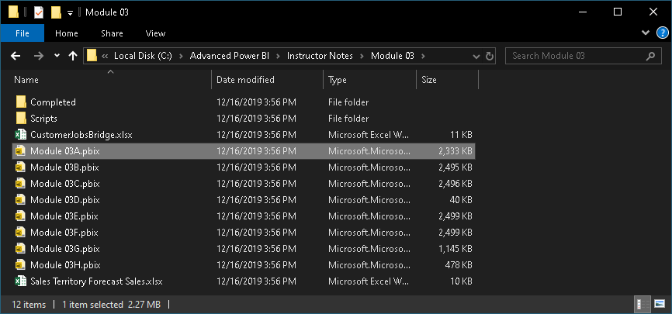
Module 03
C:\Advanced Power BI\Instructor Notes\Module 03\Module 03A.pbix

Slide 16
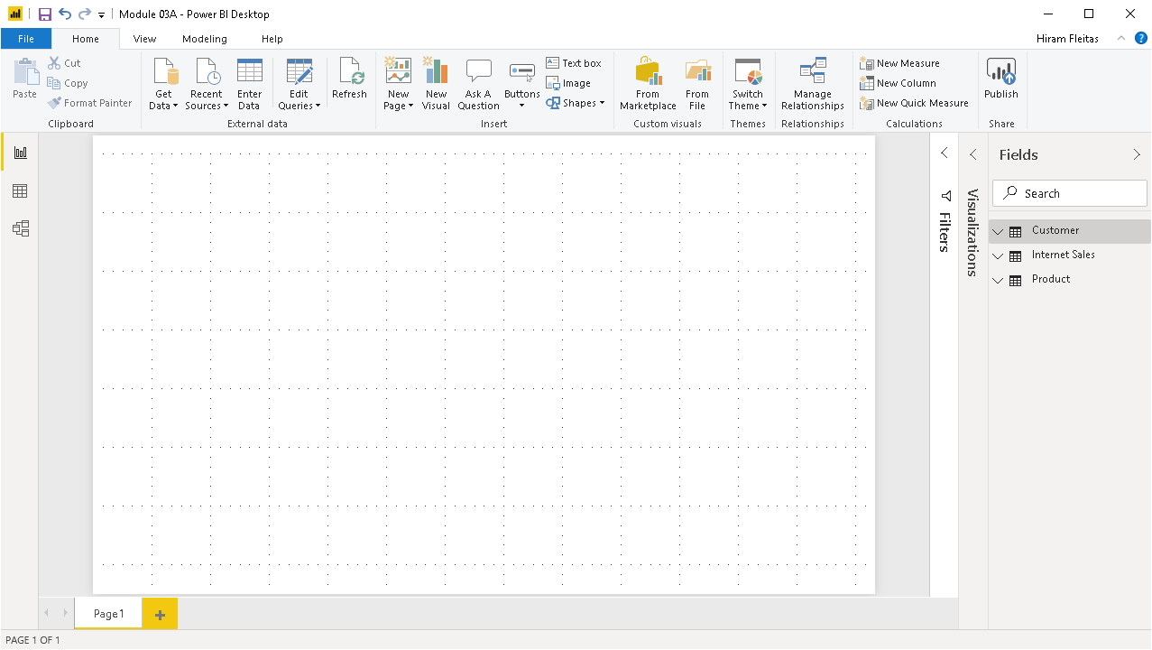

Notes:
3 simple tables. Internet Sales table (or bridge table) holds the relationship between Customer and Product.

Slide 17
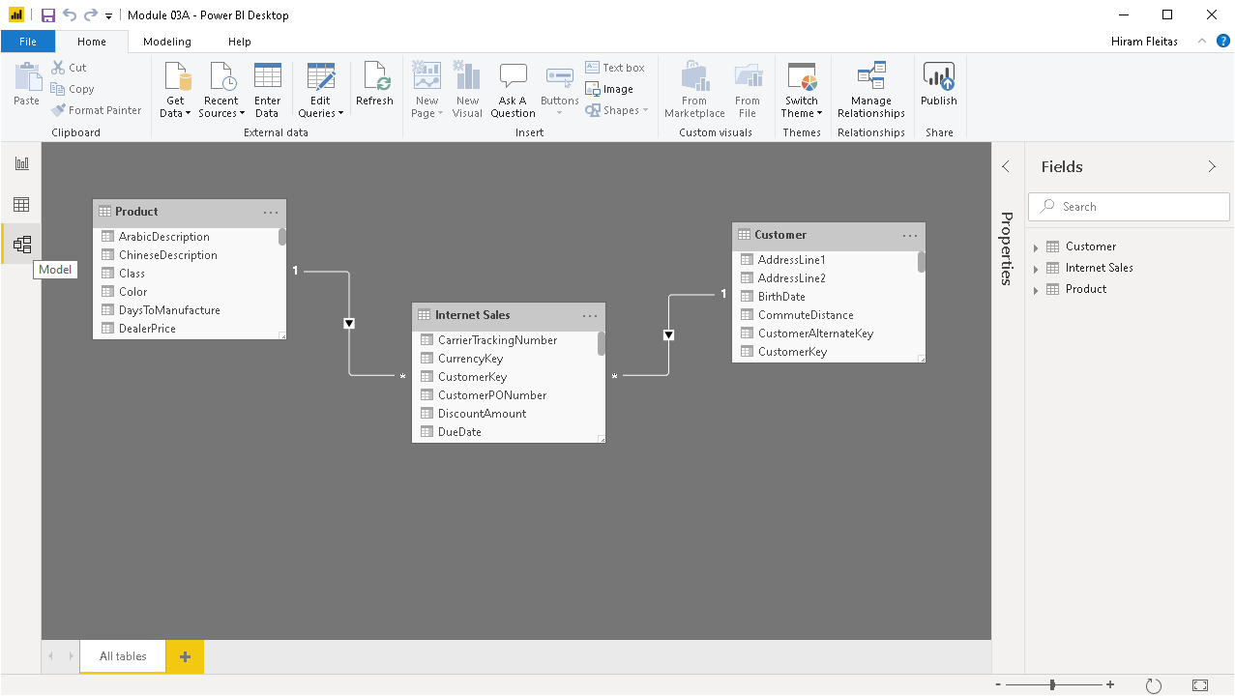

Slide 18
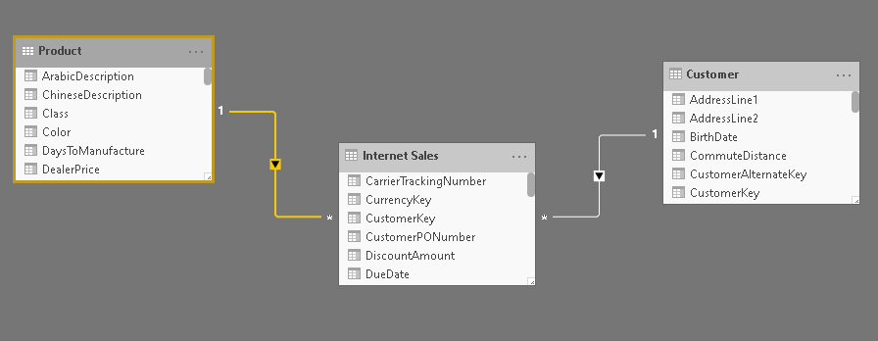
The One-side of the relationship
Directional triangle, indicating Product filters Internet Sales
Directional triangle, indicating Customer filters Internet Sales
The Many-side of the relationship
Notes:
Power BI is great at visually easily showing us the current relationships that we have.

Slide 19
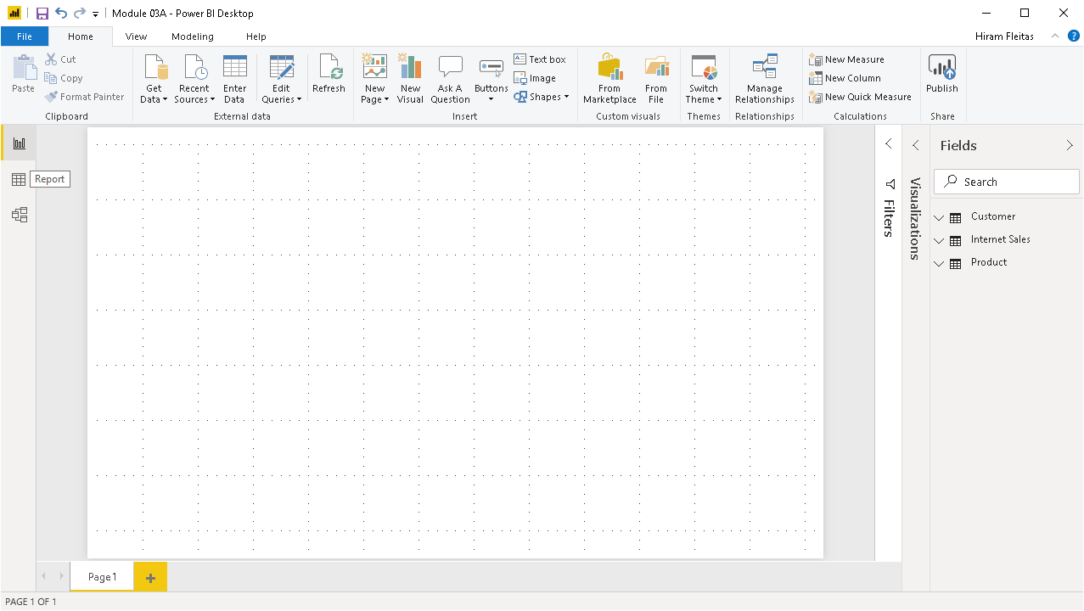

Slide 20
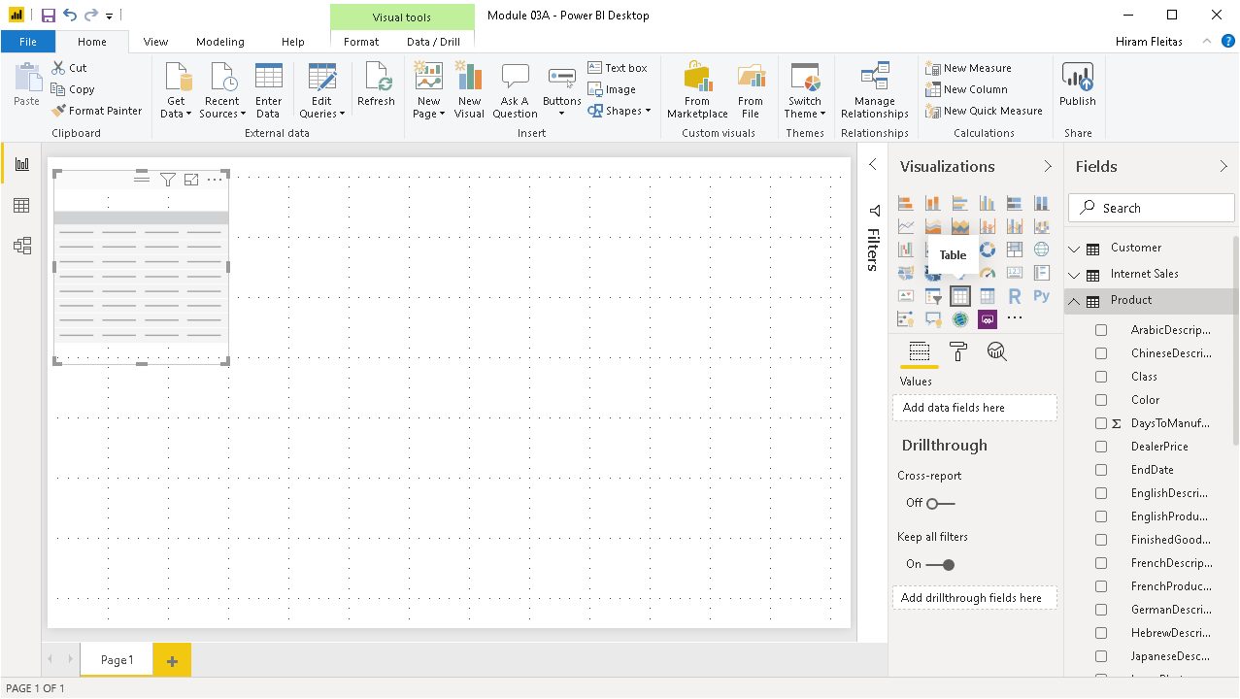

Slide 21
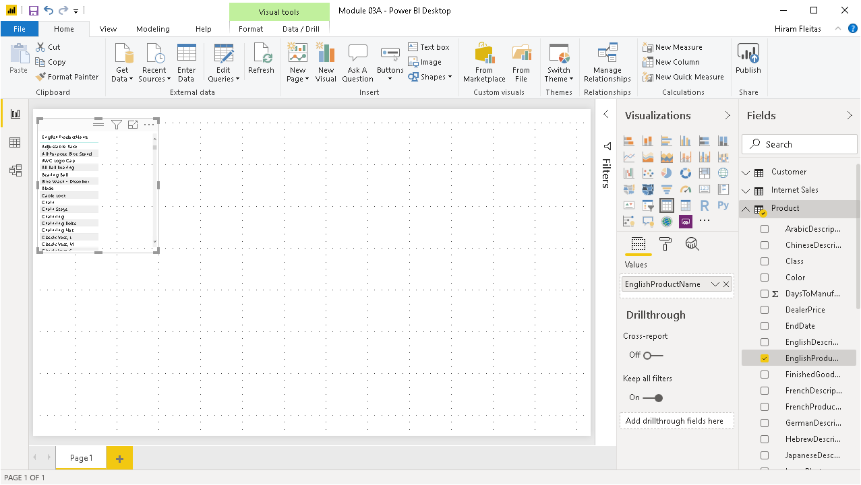

Slide 22
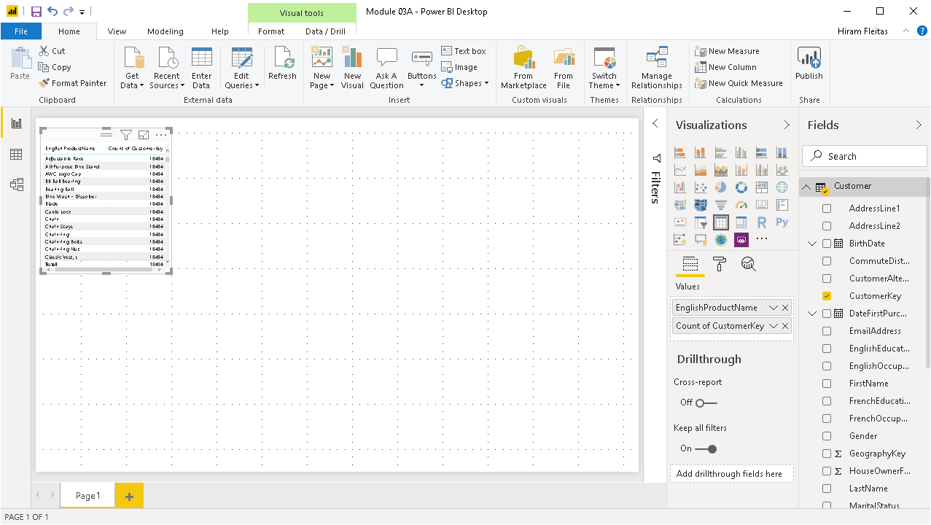

Slide 23
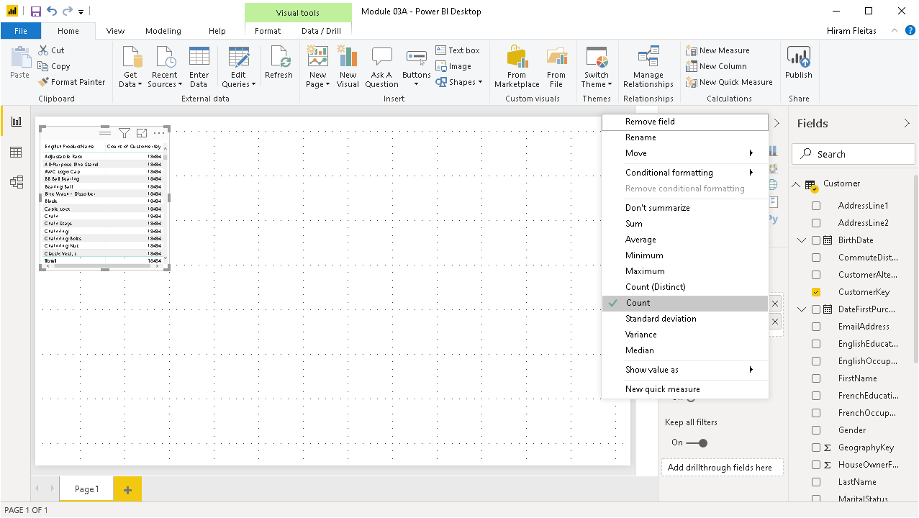

Slide 24
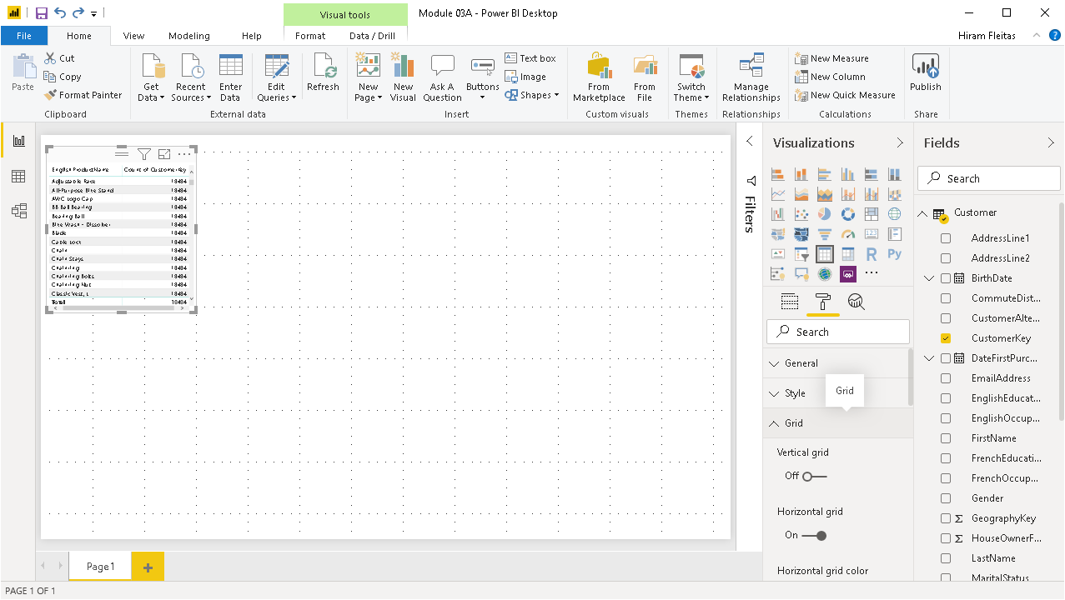

Slide 25
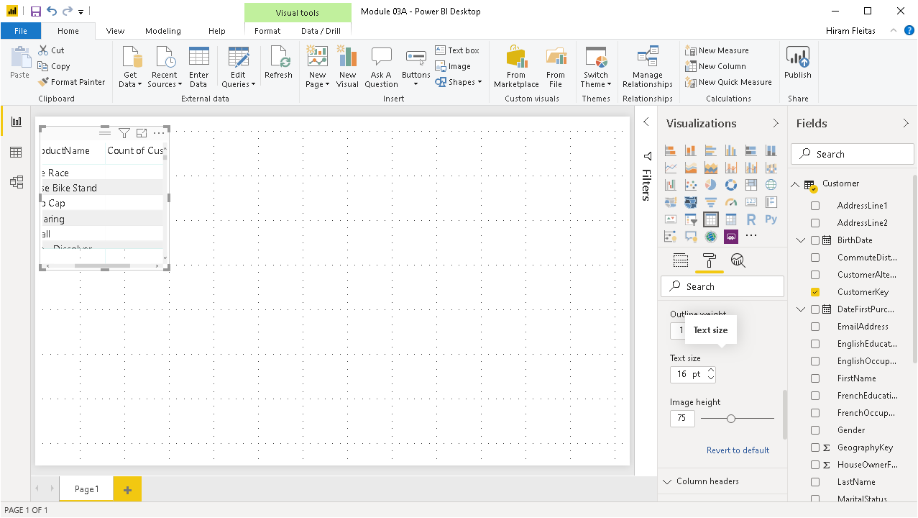

Slide 26
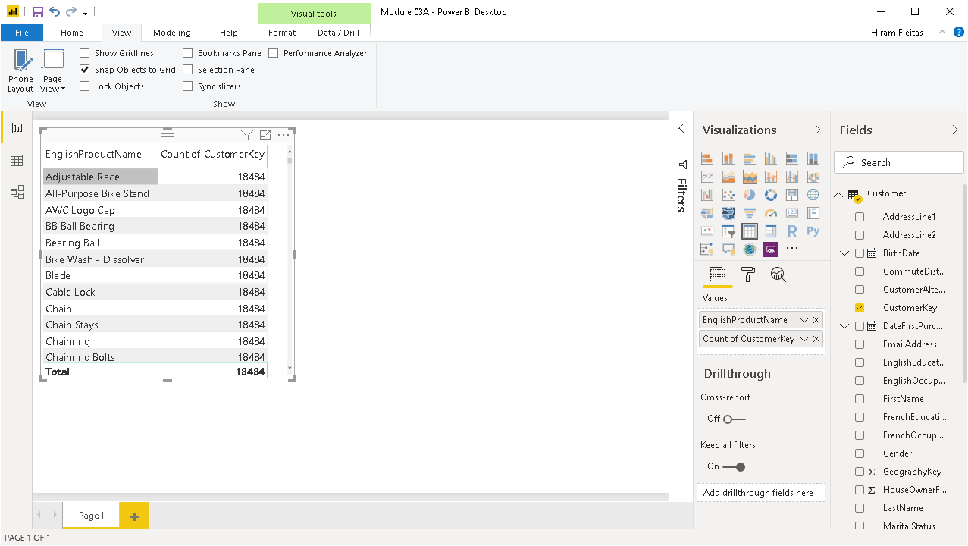
Duplicated value, typically due to a relationship doesn’t exist or its on the wrong column or data type.
We want a count of only the customers who purchased that product, not every single customer in the table.
Notes:
The fact table is not able to filter down the Customer table. Once we understand filtering and cross-filtering, this is a very easy problem to solve. We need to turn on Cross-Filtering to solve this problem.

Slide 27
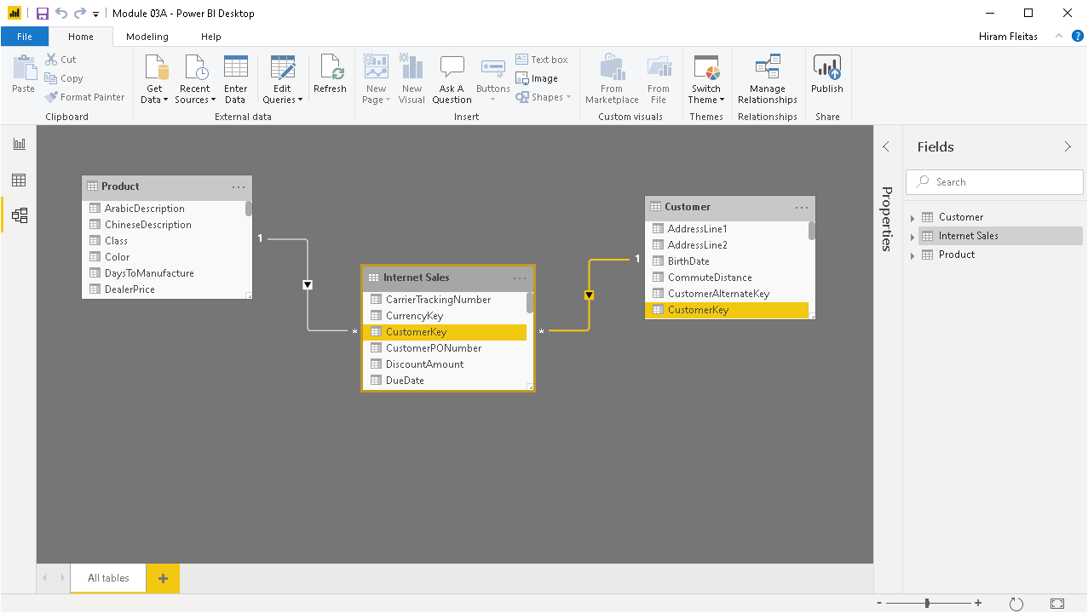
Double-click the relationship

Slide 28
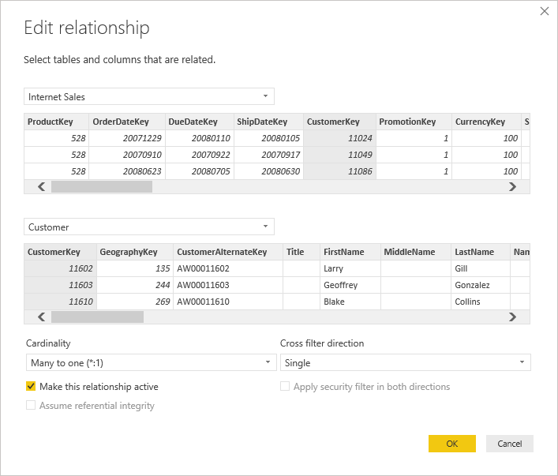
1st
2nd
Verify the relationship is built correctly. It is on CustomerKey.
Internet Sales to Customer

Slide 29
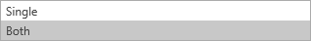

Slide 30
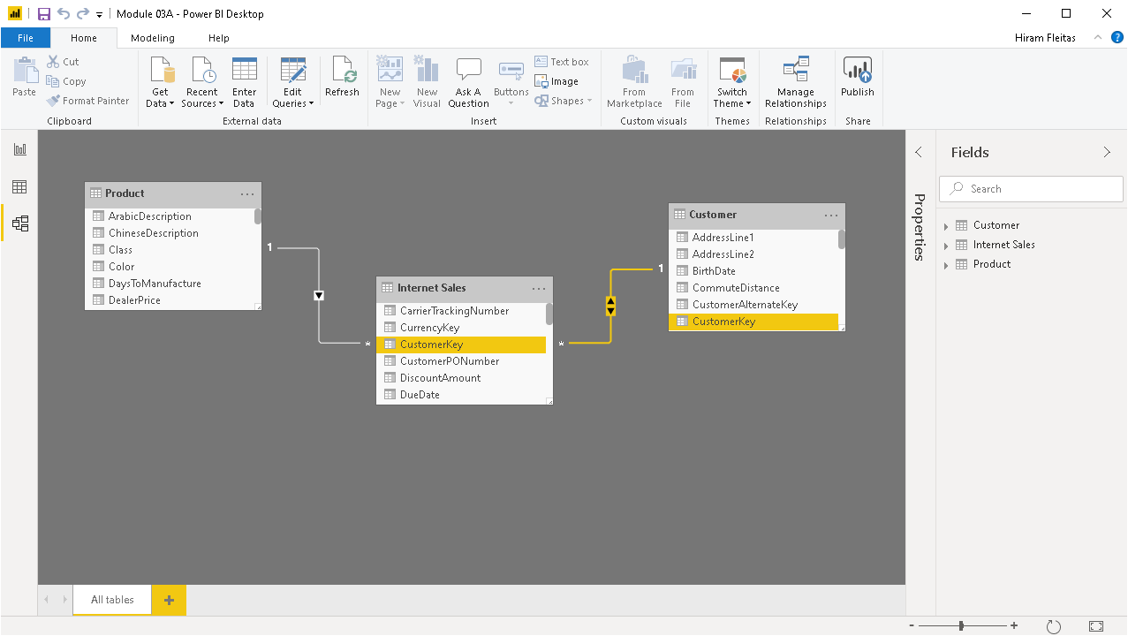
Notice the arrow now goes in BOTH directions
Notes:
IMPORTANT: If the Internet Sales table is filtered by anything else, it will allow to filter the Customer table.

Slide 31
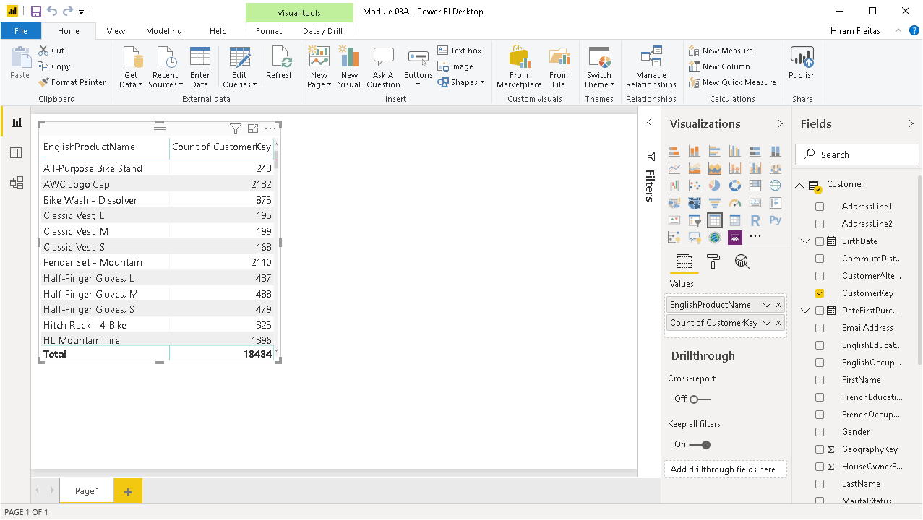
Notice our results have changed. Without having to write T-SQL or MDX or any verbose code.
This is one simple measure because of the relationship in the data model.

Slide 32
Review
Relationships
Pop-Up Quiz # 1
bit.ly/pbi18
One to Many
Many to Many
Filtering
Single (default)
Both
Notes:
We covered very important concepts, first one to many. What is the one side and what is the many side. Then how you can come up with interesting reports around that. For examples, Customers that bought products. Then we talked about single side filtering, default behavior. The one side relationship always filters the many side. Then we talked about Both, this is where the single side can filter the many side AND the many side can filter the single side.

Slide 33
Advanced Data Modeling
Cross-Filtering and Time Intelligence
We’re going to focus now more on Time Intelligence
Notes:
We’re going to focus now more on Time Intelligence

Slide 34
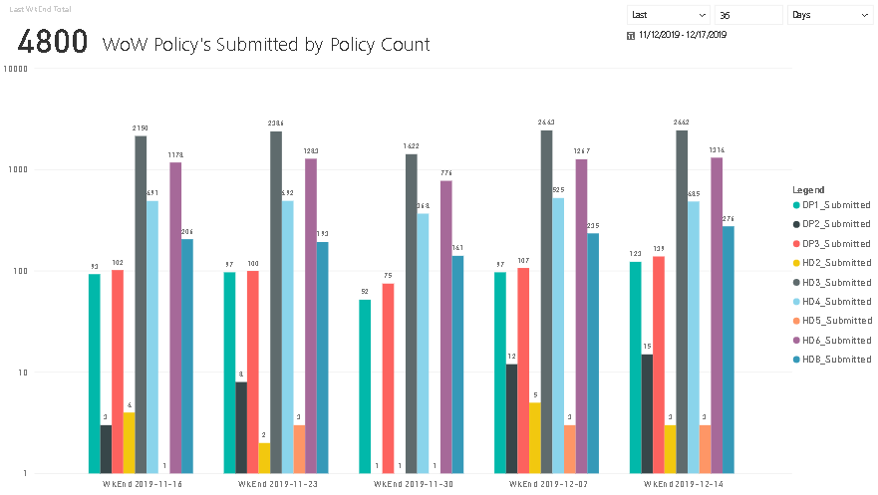
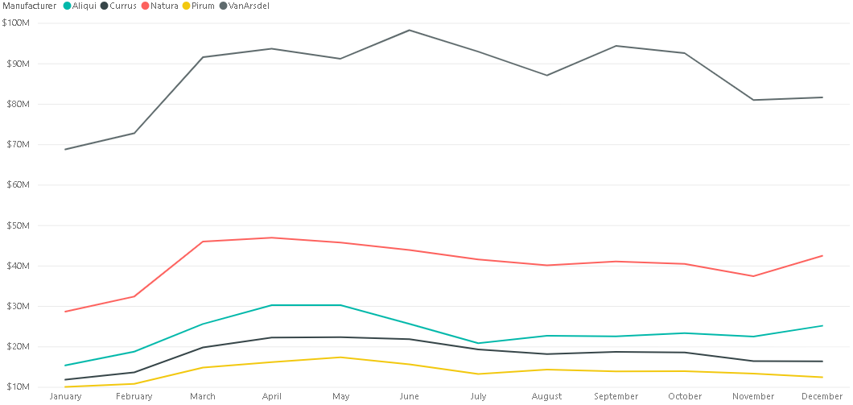
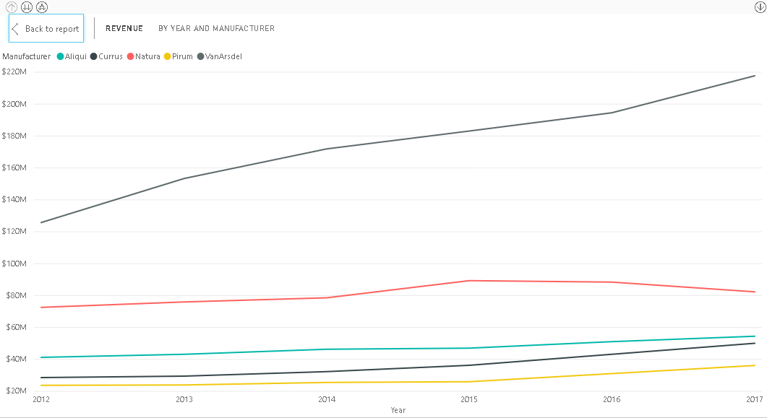
Using Time Intelligence
Comparing Data over Time
Year-to-Date
Year Over Year Growth
Using a Date Table
We’re looking at our data but in perspective of time. This year vs last year. So when you’re working with Time Intelligence you need to have a separate table that has a column that has all the dates.
Source:
http://fleitasarts.com, PBI (Demo)
Notes:
We’re looking at our data but in perspective of time. This year vs last year. So when you’re working with Time Intelligence you need to have a separate table that has a column that has all the dates.

Slide 35
Year over Year
Source:
http://fleitasarts.com, PBI (Demo)

Slide 36
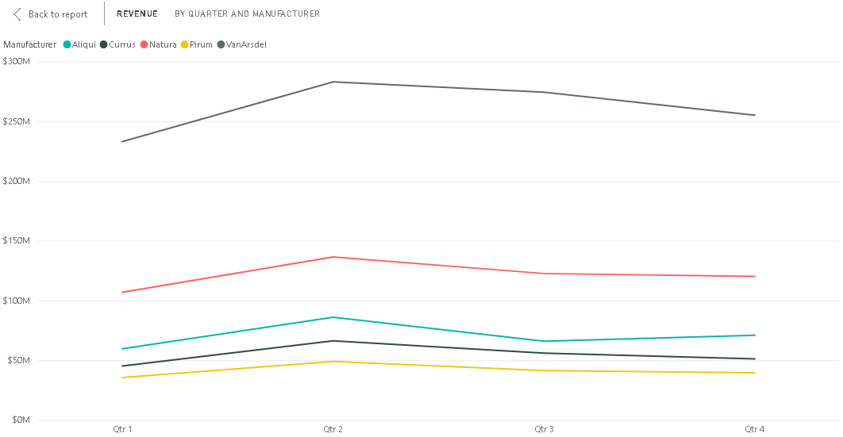
Quarter over Quarter
Source:
http://fleitasarts.com, PBI (Demo)

Slide 37
Month over Month
Source:
http://fleitasarts.com, PBI (Demo)

Slide 38
Week over Week
Source:
http://fleitasarts.com, PBI (Demo)

Slide 39
Creating Date Tables
Date Table Requirements
DateKey | DateLabel
1/1/2019 12:00:00 AM | 2019-01-01
1/2/2019 12:00:00 AM | 2019-01-02
1/3/2019 12:00:00 AM | 2019-01-03
1/4/2019 12:00:00 AM | 2019-01-04
1/5/2019 12:00:00 AM | 2019-01-05
1/6/2019 12:00:00 AM | 2019-01-06
1/7/2019 12:00:00 AM | 2019-01-07
1/8/2019 12:00:00 AM | 2019-01-08
1/9/2019 12:00:00 AM | 2019-01-09
1/10/2019 12:00:00 AM | 2019-01-10
1/11/2019 12:00:00 AM | 2019-01-11
One row for every date.
Span range of possible dates.
Import from source or create a new table in DAX.
Mark as a Date Table in Model (Tabular).
Date column passed to Time Intelligence functions.
Notes:
The date table needs to have a row for every possible date. Dates that span all ranges. Because if you setup cross-filtering between your date table and your transactions table, it’s going to allow the transactions table to filter the date table. If it can filter the date table, then dates will disappear from your date table and disappear. Therefore it wont span all possible date ranges so time intelligence doesn’t work.

Slide 40
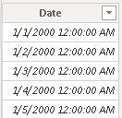
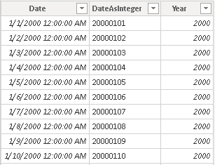
Create a Date Table in DAX
Method 1
Date =
CALENDAR ( DATE ( 2000, 1, 1 ), DATE ( 2025, 12, 31 ) )
Method 2
Date =
ADDCOLUMNS (
CALENDAR ( DATE ( 2000, 1, 1 ), DATE ( 2025, 12, 31 ) ),
"DateAsInteger", FORMAT ( [Date], "YYYYMMDD" ),
"Year", YEAR ( [Date] )
)
Steps
Under Modeling, click New Table, and paste in formula bar.
Notes:
The date table needs to have a row for every possible date. Dates that span all ranges.

Slide 41
Create a Date Table in DAX
Method 3
Date =
ADDCOLUMNS (
CALENDAR ( DATE ( 2000, 1, 1 ), DATE ( 2025, 12, 31 ) ),
"DateAsInteger", FORMAT ( [Date], "YYYYMMDD" ),
"Year", YEAR ( [Date] ),
"Monthnumber", FORMAT ( [Date], "MM" ),
"YearMonthnumber", FORMAT ( [Date], "YYYY/MM" ),
"YearMonthShort", FORMAT ( [Date], "YYYY/mmm" ),
"MonthNameShort", FORMAT ( [Date], "mmm" ),
"MonthNameLong", FORMAT ( [Date], "mmmm" ),
"DayOfWeekNumber", WEEKDAY ( [Date] ),
"DayOfWeek", FORMAT ( [Date], "dddd" ),
"DayOfWeekShort", FORMAT ( [Date], "ddd" ),
"Quarter", "Q" & FORMAT ( [Date], "Q" ),
"YearQuarter", FORMAT ( [Date], "YYYY" ) & "/Q"
& FORMAT ( [Date], "Q" )
)
Notes:
The date table needs to have a row for every possible date. Dates that span all ranges.

Slide 42
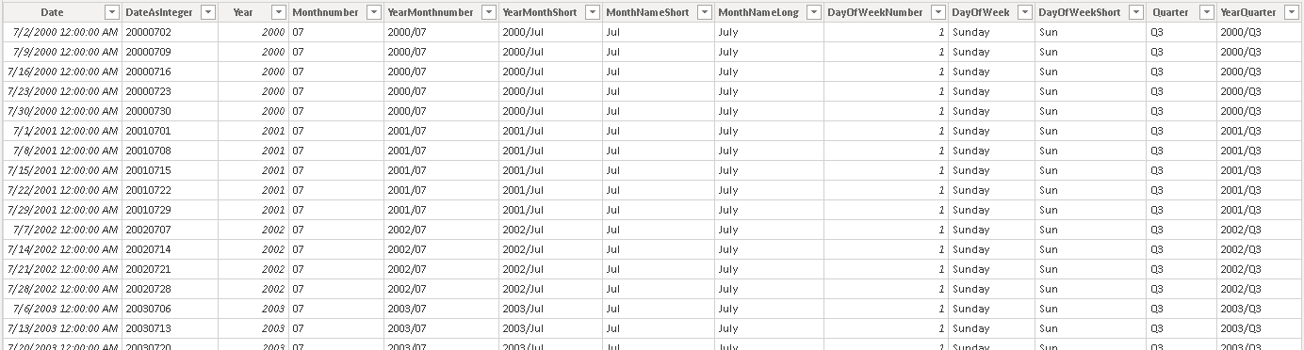
Create a Date Table in DAX
Method 3

Slide 43
Cross Filtering
Products
Sales
Date
ProdID | Name | Price
101 | Bike | 250
102 | Socks | 10
103 | Shoes | 120
104 | Helmet | 150
105 | Gloves | 45
DateSK | ProdID | Amt | QTY
20190101 | 102 | 250 | 1
20190101 | 101 | 20 | 2
20190102 | 101 | 45 | 1
20190103 | 105 | 45 | 1
20190103 | 104 | 150 | 1
20190104 | 104 | 150 | 1
20190105 | 101 | 250 | 1
DateSK | Date
20190101 | 1/1/2019
20190102 | 1/2/2019
20190103 | 1/3/2019
20190104 | 1/4/2019
20190105 | 1/5/2019
Question
How many dates was a product purchased?
Bikes 3, Socks 1, Shoes 0. But Time Intelligence breaks due to filtered date table. Its not a continuous range of dates.

Slide 44
Cross Filtering and Time Intelligence
DEMO 2
In this demo, we take a look at when we transition from a single sided relationship to a cross-sided relationship.
Notes:
In this demo, we take a look at when we transition from a single sided relationship to a cross-sided relationship.

Slide 45
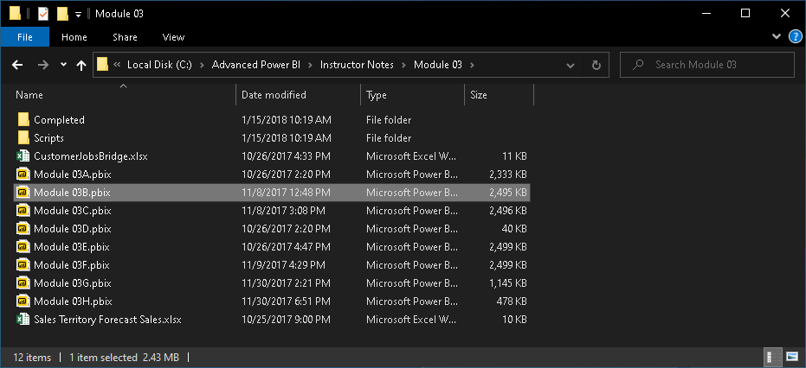
Module 03
C:\Advanced Power BI\Instructor Notes\Module 03\Module 03B.pbix

Slide 46
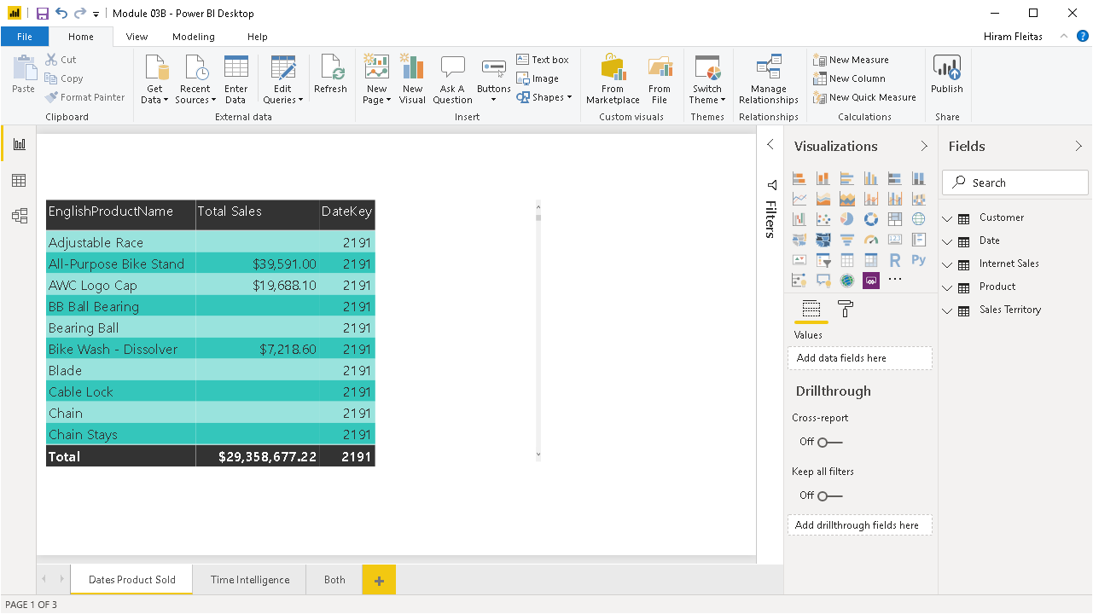
Request: List of products and the count of days that product sold on.
Notice values are identical. That is the count of the records in the date table.
Notes:
An internal customer asked I need a report, with the list of product and the count of days the product sold on.

Slide 47
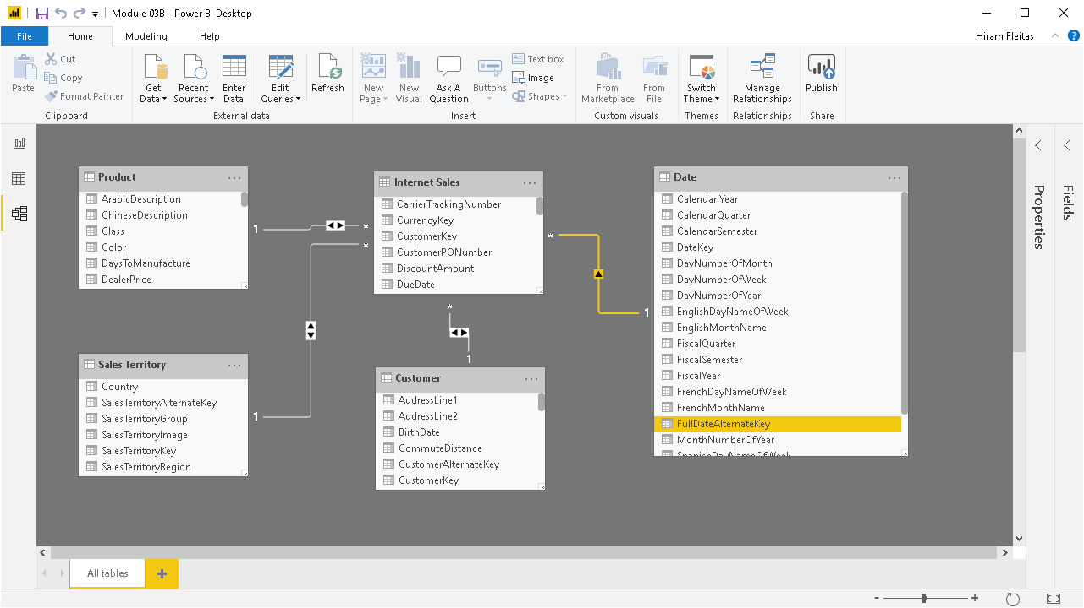

Slide 48
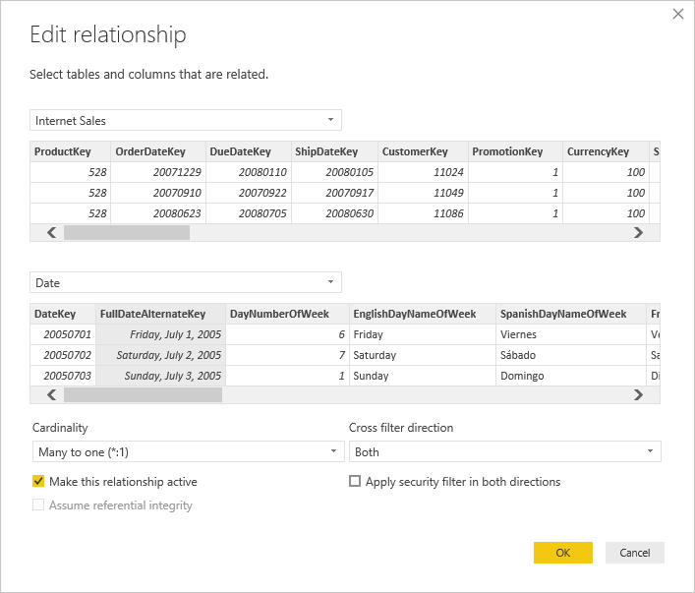
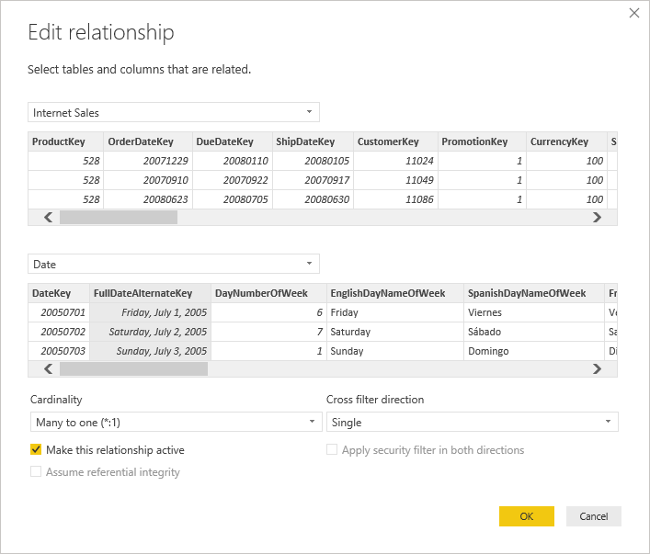

Slide 49


Slide 50
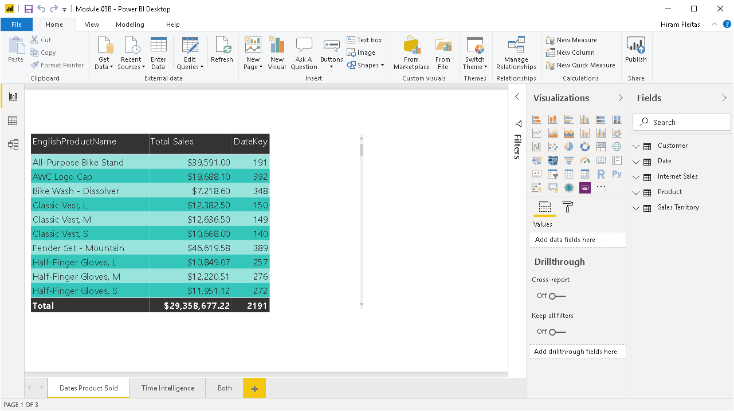
Request: List of products and the count of days that product sold on.
Now we see, correctly, exactly how many days each product sold.
However, this will effect any time intelligence you have in your data model. Let me show you …

Slide 53
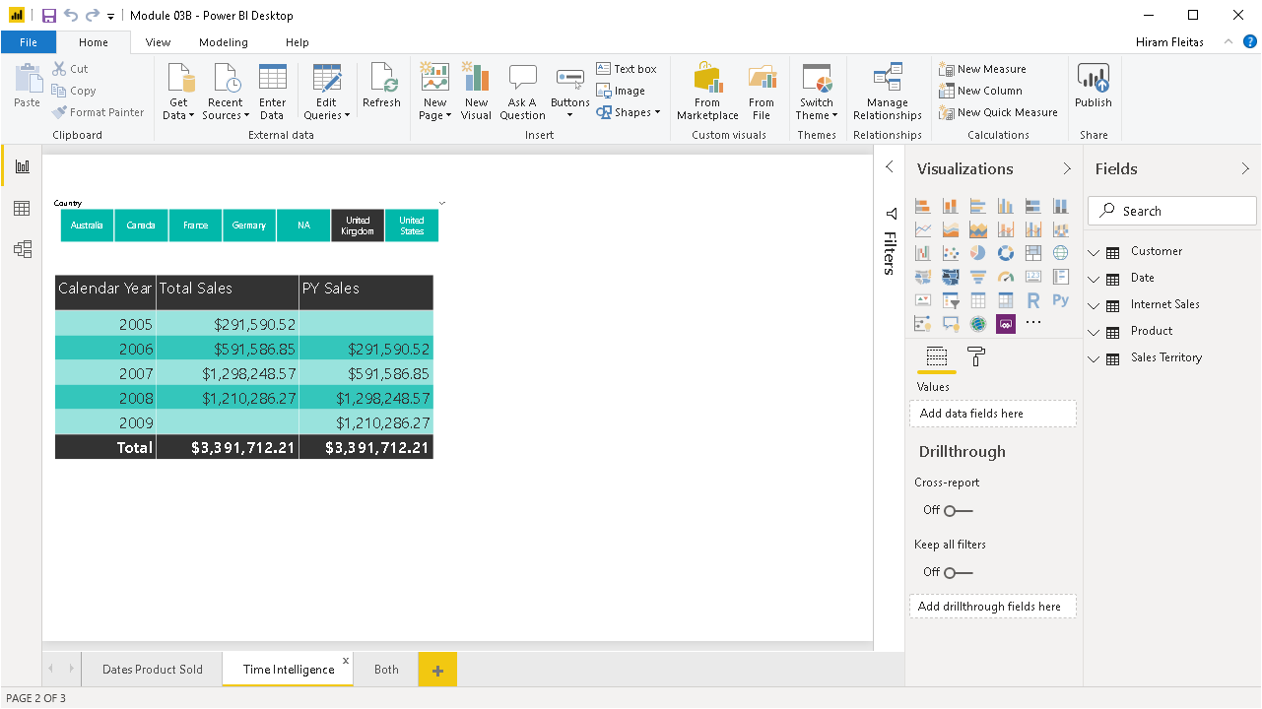
We have Total Sales and Previous Year Sales.

Slide 54
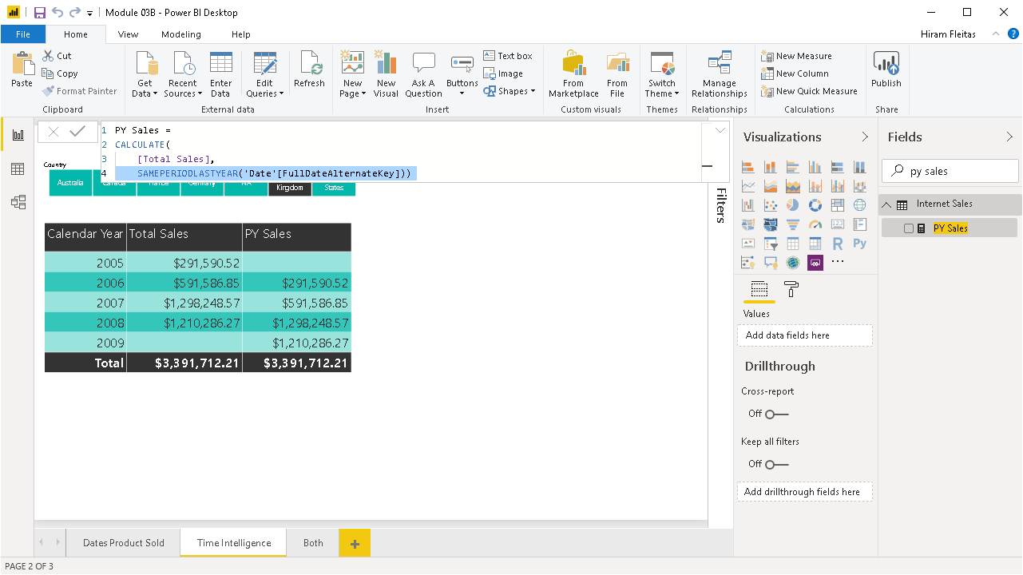
You can see the Calculated Measure DAX formula for PY Sales.
Learn More:
https://docs.microsoft.com/dax/sameperiodlastyear-function-dax

Slide 55
Next: Remove filter by United Kingdom

Slide 56
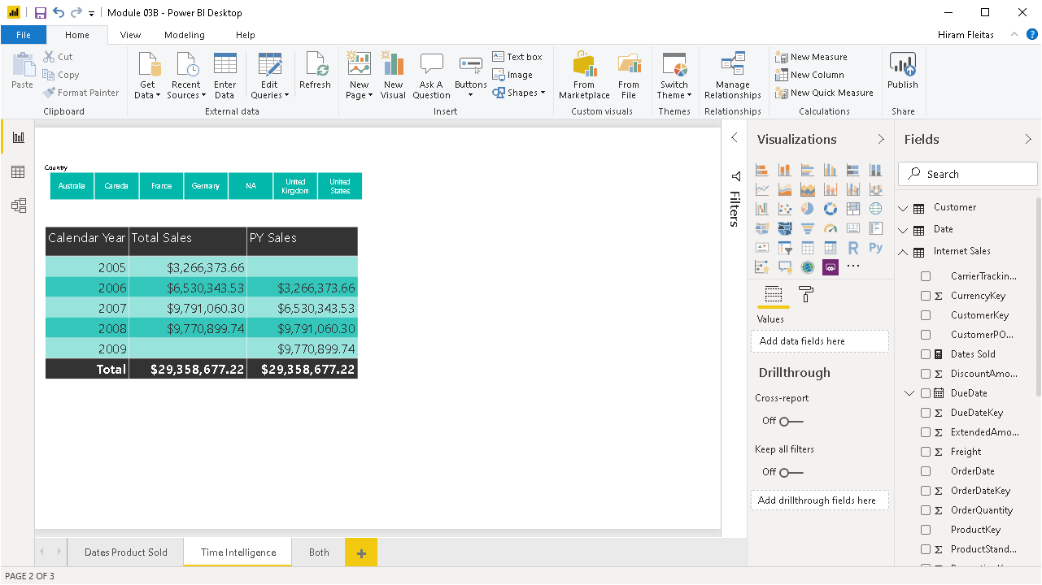

Slide 58

No issues there, until you filter back by a Country or a Product.

Slide 59
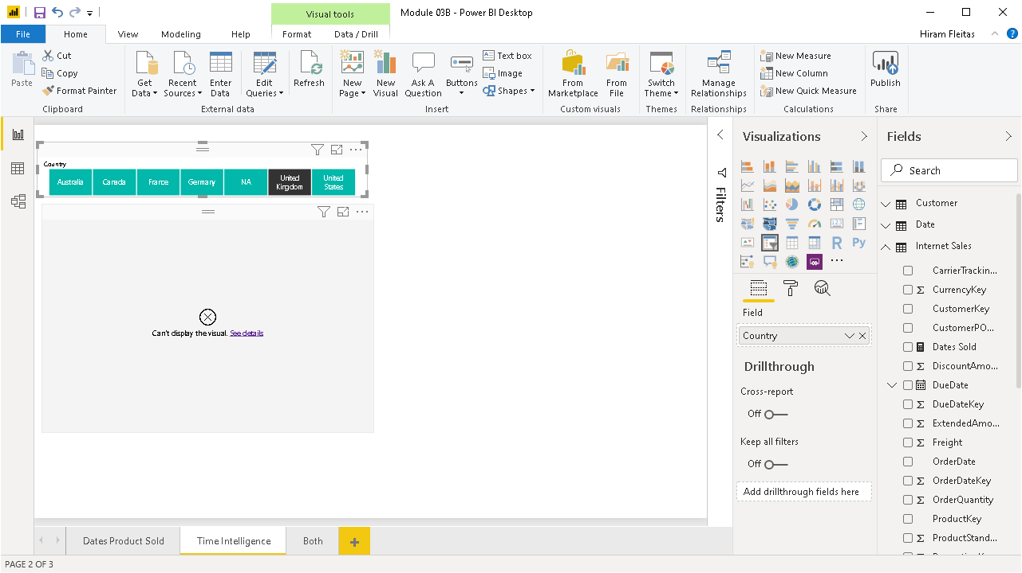
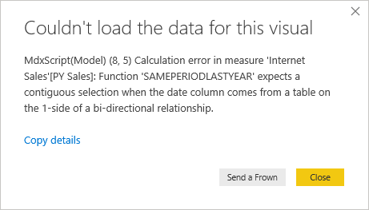
Click United Kingdom and boom!
In other words, we must have all dates of the entire year for the entire date range.
Takeaway: Do not turn-on bi-directional filtering to your date table. If need both, then bring-in a 2nd date table & configure calculations of that table but it can cause confusion to your users. Or, you can build many to many calculations using DAX.

Slide 61
Review
Date Table Requirements
Pop-Up Quiz # 2
bit.ly/pbi18
One row for every possible date
Span range of possible dates
Cross Filtering and Time Intelligence
This is a great feature that Microsoft has put into Power BI.
Note, additional date tables can consume more memory in your model. The other option via DAX to calculate the measure would per attribute ie. product, country, etc. And, that also adds a little more overhead.

Slide 62
Advanced Data Modeling
Many to Many with DAX
We covered why you shouldn’t turn-on Both direction filtering, because it messes up that continuous range of dates that I am working with and that can ultimately break time intelligence. How can you have the best of both worlds?
Notes:
We covered why you shouldn’t turn-on Both direction filtering, because it messes up that continuous range of dates that I am working with and that can ultimately break time intelligence. How can you have the best of both worlds?

Slide 63
Cross-Filtering with Date Table
Enabled
This is how the model looks like when we enable cross-filtering. But, when we looked at one of our report visuals that had time intelligence, it no longer worked. We know that we don’t want to turn on both directions. Before, Microsoft introduced bi-directional filtering, we handled this using DAX in a couple lines of code specially with the Calculate function.
Notes:
We’re looking at our data but in perspective of time. This year vs last year. So when you’re working with Time Intelligence you need to have a separate table that has a column that has all the dates.

Slide 64
Many to Many support with DAX
Pseudo Code:
CALCULATE (
<Aggregate>,
<Bridge Table>)
More Info:
Take essentially our aggregation, whatever it is, and wrap that around the calculate statement. The calculate is going to take that aggregation as the first parameter. The second, parameter is very simple. It just the name of the bridge table in your data model. For the most part, we don’t use this code anymore since bi-directional support was made available. However, in a situation like this Calculate is going to be very good.
Notes:
The date table needs to have a row for every possible date. Dates that span all ranges.

Slide 65
Many to Many with DAX
DEMO 3
We covered why you shouldn’t turn-on Both direction filtering, because it messes up that continuous range of dates that I am working with and that can ultimately break time intelligence. How can you have the best of both worlds?
Notes:
We covered why you shouldn’t turn-on Both direction filtering, because it messes up that continuous range of dates that I am working with and that can ultimately break time intelligence. How can you have the best of both worlds?

Slide 66
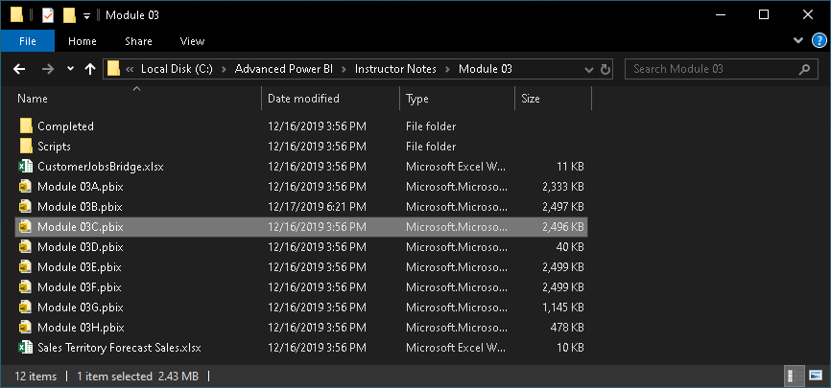
Module 03
C:\Advanced Power BI\Instructor Notes\Module 03\Module 03C.pbix

Slide 67
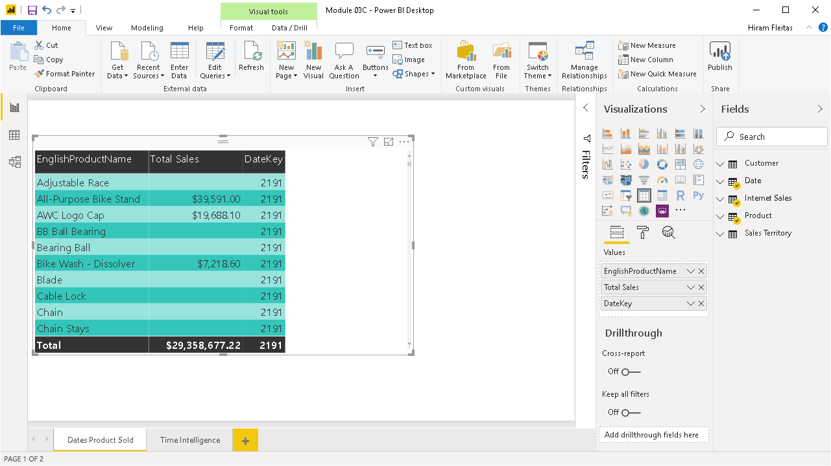
Recall the initial problem. We brought the DateKey and did a count.
Then we got this duplicated value due to not having a valid relationship.

Slide 68
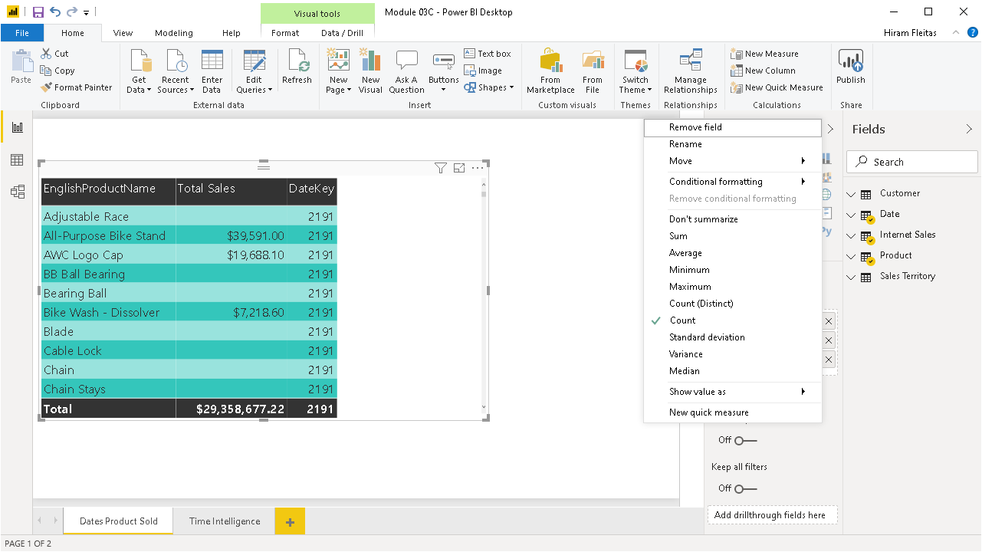
Recall the initial problem. We brought the DateKey and did a count.
Then we got this duplicated value due to not having a valid relationship.

Slide 69
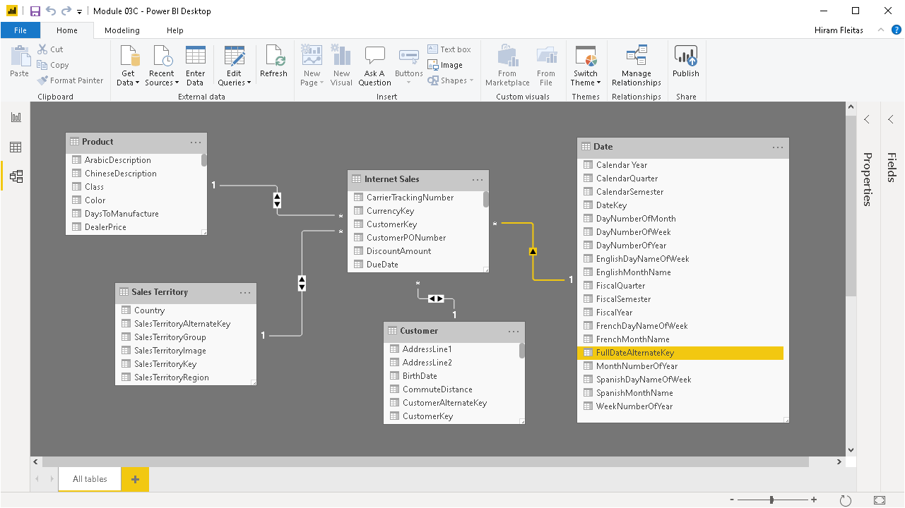
Notes:
The product table is unable to filter the date table. The relationship we can see that Product filters the Internet Sales table, but it stops there and does not go through to the Date table. We know Both direction would break time intelligence.

Slide 70
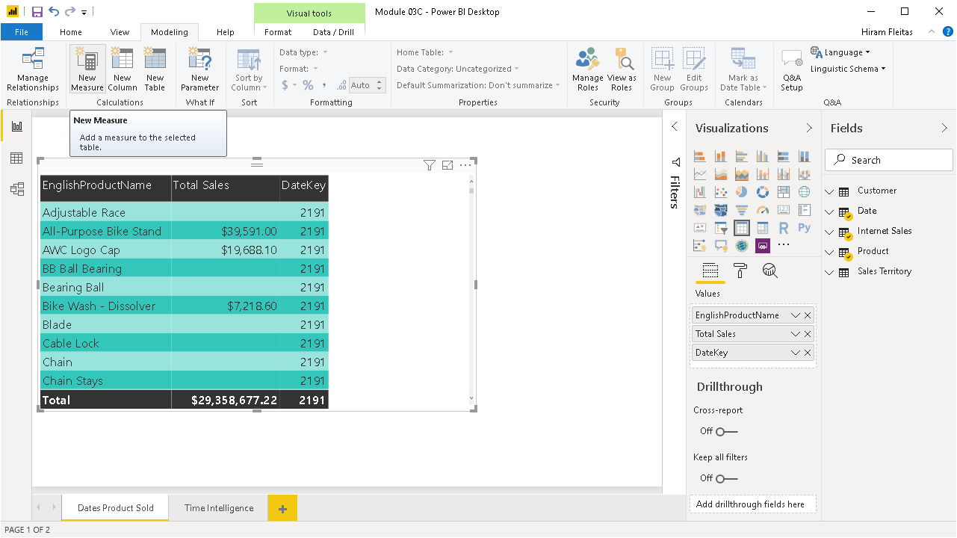
To solve a problem like this, we say first we just need to count the number of rows in my date table. So we create a New Measure.
Notes:
To solve a problem like this, we say first we just need to count the number of rows in my date table. So we create a New Measure.

Slide 71
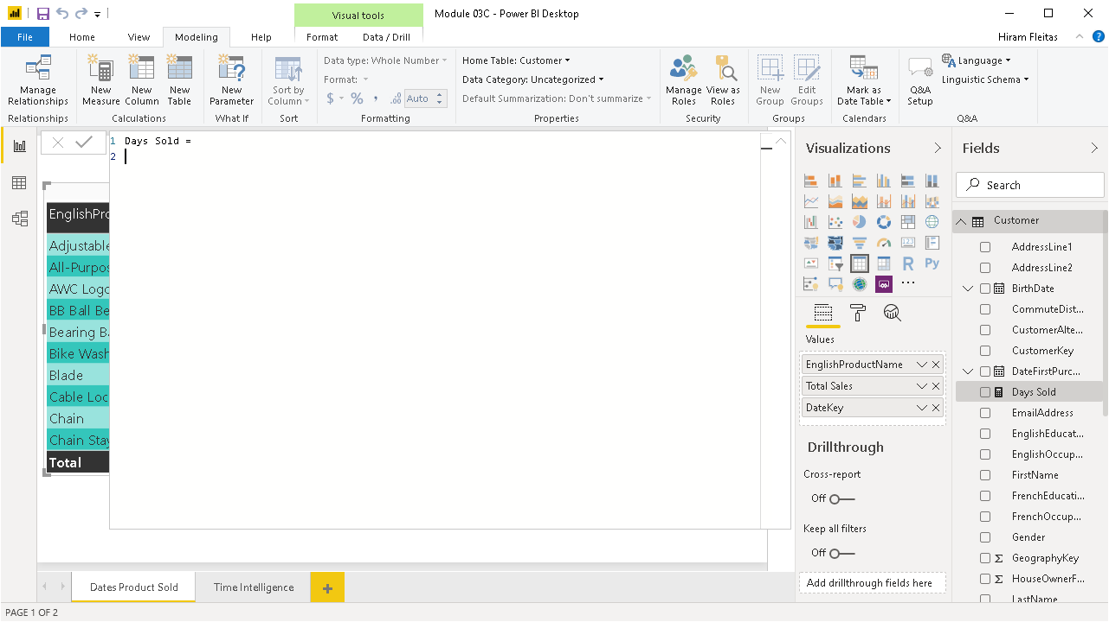
We’re going to say Days Sold, not Days Product Sold because it can have multiple usage.
Tip: press Shift + Enter to break the line.

Slide 72
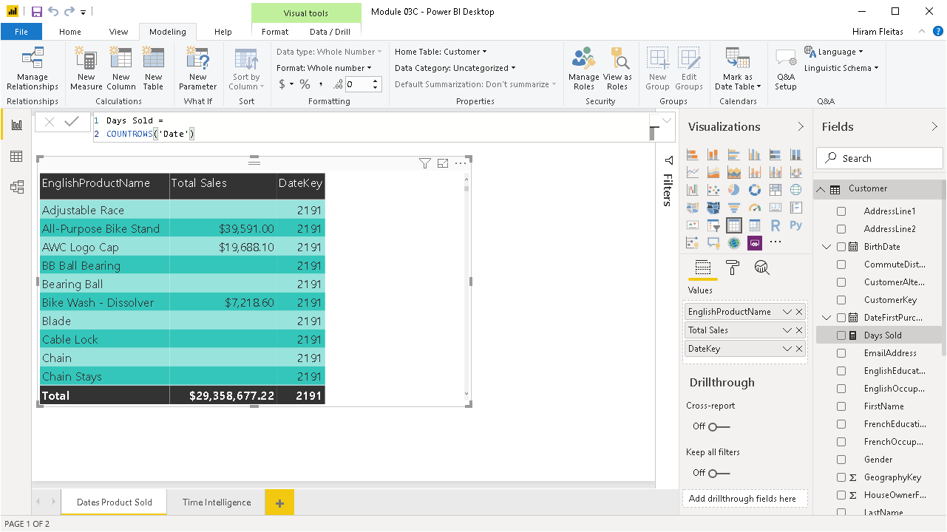

Slide 73
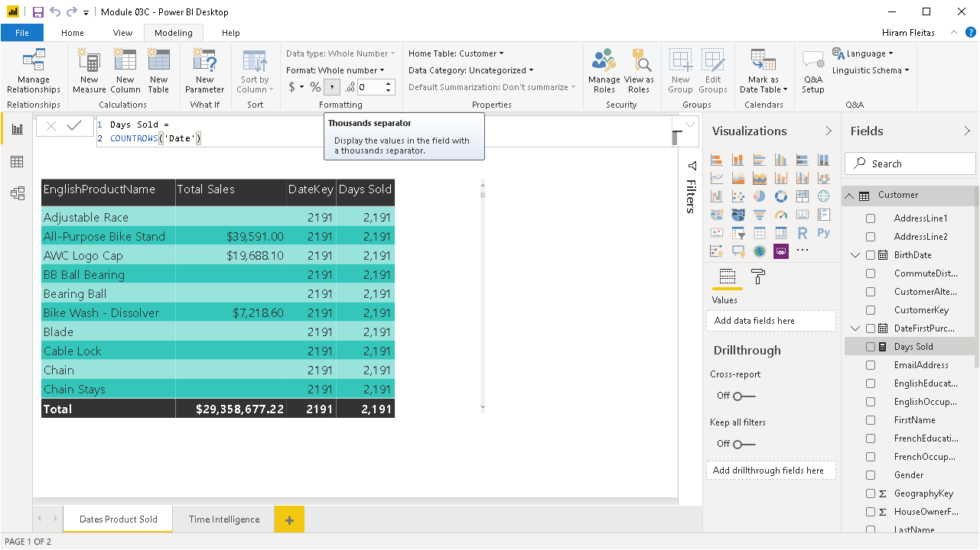
Benefit: Measures can be formatted.
After adding the field to our visual we’re getting the same result.
Now we can remove DateKey and use the new DAX calculated measure as the recommended method.

Slide 74
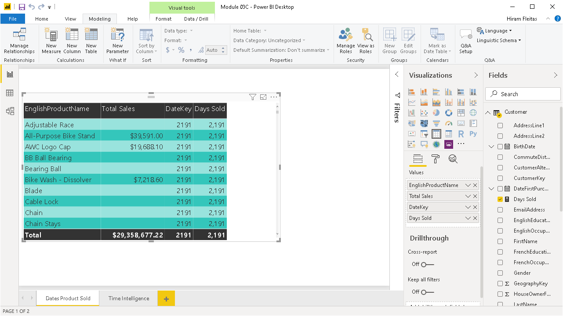

Slide 75
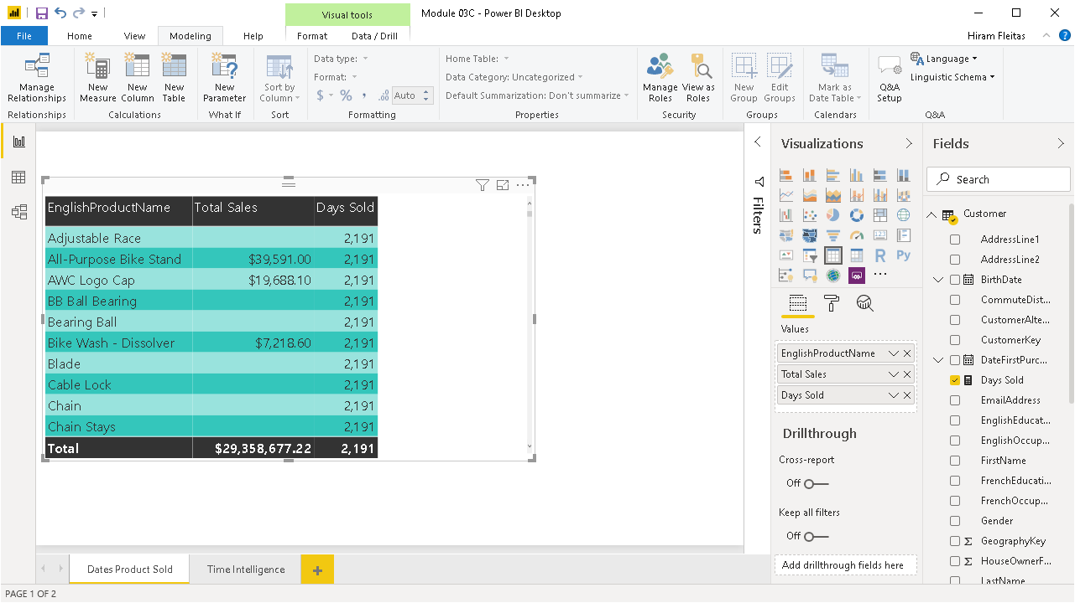
Now, how do we solve this problem without turning on bi-directional or cross filtering?
By using DAX!

Slide 76
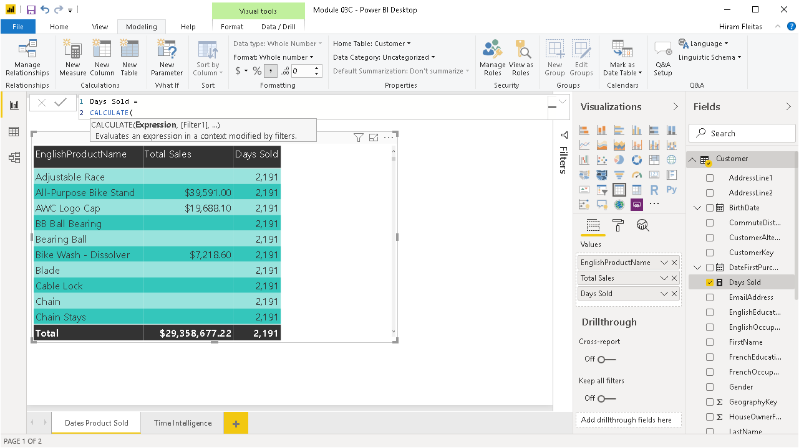
We’re going to use Calculate.

Slide 77
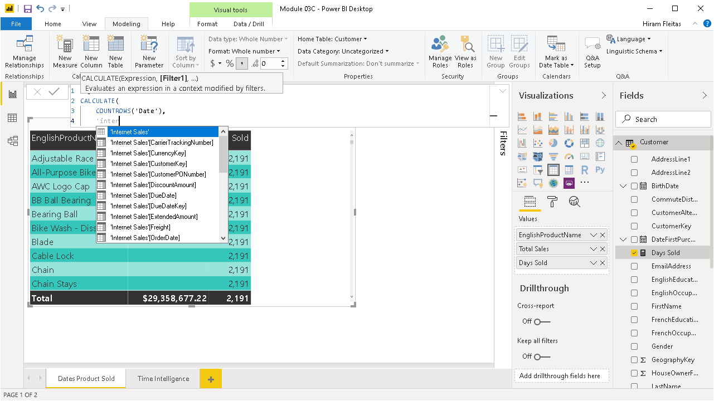
We’re going Calculate our measure and use Internet Sales as the bridge table.

Slide 78

It works!

Slide 79

A product can be sold on many dates. A date can have multiple products. So there’s a many to many relationship between these to tables, but there’s no way to build a relationship.
If you add a product to the date table, that wouldn’t work cause you would have only one product per date and vise versa on if you try it on the product table. What we need is a bridge table to store the relationship of when every single time a product sold and when it sold on.

Slide 80
Calculate allows us to control the filter context. It says use the bridge table and pass the filter through that bridge table.

Slide 81

If we look at Time Intelligence, you can see it still works and now we have the best of both worlds.
Now, we have solved the business problem!

Slide 82
Review
Bi-Directional Filtering
Pop-Up Quiz # 3
bit.ly/pbi18
Problem with the date table
Solving the problem using DAX
Many to Many with DAX
Specifically the reason why we don’t use this anymore is because now we can just turn on Both directions, which we didn’t have in the past.

Slide 83
Advanced Data Modeling
Creating a Bridge Table
Lets discuss the concept of building a bridge table. Users will bring multiple tables and try to build a relationship between them but they can’t cause there’s no valid relationship to be built. It goes back to this concept of a Many to Many relationship bridge table. So we’ll cover why we need a bridge and what it looks like in a very simple example.
Notes:
Lets discuss the concept of building a bridge table. Users will bring multiple tables and try to build a relationship between them but they can’t cause there’s no valid relationship to be built. It goes back to this concept of a Many to Many relationship bridge table. So we’ll cover why we need a bridge and what it looks like in a very simple example.

Slide 84

Creating a Bridge Table (Factless Fact)
Customers
CustomerID
CustomerName
Address
Jobs
JobID
JobName
Description
CustomerJobBridge
BridgeID
CustomerID
JobID
A bridge table is a table that essentially stores a relationship between two tables. What most people do, is add the JobID to the Customers table. That works one time, until you have a customer that’s had multiple jobs in the last few months; therefore, this doesn’t work anymore. So that’s not a good way to build a relationship and a lot of times that’s not even an option. A better way is a bridge table. Each customer will have an entry in the bridge table for each job that they held, plus other attributes ie. start date, etc.
Notes:
We’re looking at our data but in perspective of time. This year vs last year. So when you’re working with Time Intelligence you need to have a separate table that has a column that has all the dates.

Slide 85
Creating a Bridge Table (Factless Fact)
Customers
CustomerID
CustomerName
Address
Jobs
JobID
JobName
Description
CustomerJobBridge
BridgeID
CustomerID
JobID
A bridge table is a table that essentially stores a relationship between two tables. What most people do, is add the JobID to the Customers table. That works one time, until you have a customer that’s had multiple jobs in the last few months; therefore, this doesn’t work anymore. So that’s not a good way to build a relationship and a lot of times that’s not even an option. A better way is a bridge table. Each customer will have an entry in the bridge table for each job that they held, plus other attributes ie. start date, etc.
Notes:
It doesn’t have basic measures like Quantity, Amount, Duration, but it does have the relationship stored in it.

Slide 86
Factless Fact Table (Bridge)
DEMO 4
Lets discuss the concept of building a bridge table. Users will bring multiple tables and try to build a relationship between them but they can’t cause there’s no valid relationship to be built. It goes back to this concept of a Many to Many relationship bridge table. So we’ll cover why we need a bridge and what it looks like in a very simple example.
Notes:
Lets discuss the concept of building a bridge table. Users will bring multiple tables and try to build a relationship between them but they can’t cause there’s no valid relationship to be built. It goes back to this concept of a Many to Many relationship bridge table. So we’ll cover why we need a bridge and what it looks like in a very simple example.

Slide 87

Module 03
C:\Advanced Power BI\Instructor Notes\Module 03\Module 03D.pbix

Slide 88

As you can see, we only have a Customers table and a Jobs table now.

Slide 89

In the Model view we can get a better look at these tables and see there’s no way to build a relationship between them.

Slide 90

In the Data view we can the columns as well as the rows in those columns.

Slide 91

We can notice there’s one row per job and one row per customer.

Slide 92

Module 03
C:\Advanced Power BI\Instructor Notes\Module 03\CustomerJobsBridge.xlsx

Slide 93


Slide 94


Slide 95


Slide 96

Power BI automatically tries to find relationships in our model and stablish those relationships. As you can see here, it has done that and they’re all one-sided. So we want to modify this to Both directions.

Slide 97


Slide 98


Slide 99

Now we can look at some obvious questions.
How many jobs have been held by what customers?
How many jobs each customer holds?
Do customers with more jobs purchase more or purchase less?

Slide 100

Created a new measure to get a Count of Jobs cause that is the best practice.
Then added a simple table visual with the two fileds Customer and our new measure Count of Jobs to see how many jobs each customer has held.

Slide 101

The bridge table has given us all the analytical value that we were looking for.
We can also see here the types of jobs or job names by switching the field in our visual for Job Type.

Slide 102
Review
Many to Many relationships
Pop-Up Quiz # 4
bit.ly/pbi18
User scenarios that try to make it work.
Even try to flatten the table by combining into one that changes the granularity of the table.
Bridge table / Factless fact
This will be the better solution for analytical value.
Dimensions explain facts. For example, $1 million in sales is a Fact measure. For what product, country, year? Those attributes are Dimensions.
Factless fact just has the keys for many different tables to store the relationship.

Slide 103
Advanced Data Modeling
Role Playing Tables
Role Playing Tables is one of the concepts that can get confusing, but don’t over think it. A role playing table is a table that can essentially play multiple roles. For example, we have transactions that contain multiple rows. One for when the Order was Placed and another row for when the Order Shipped with another date. We have them to reduce redundancy of having to maintain multiple tables when they’re in essence the same structure. Another example is a transaction for the Bill To address and the Ship To address. Do we want two tables or just one? The tabular model of Power BI there’s no real built-in support for Role-Playing tables, unlike Multi-Dimensional version of Analysis Services that does have built-in support. We look at the two options we have here.
Notes:
Role Playing Tables is one of the concepts that can get confusing, but don’t over think it. A role playing table is a table that can essentially play multiple roles. For example, we have transactions that contain multiple rows. One for when the Order was Placed and another row for when the Order Shipped with another date. We have them to reduce redundancy of having to maintain multiple tables when they’re in essence the same structure. Another example is a transaction for the Bill To address and the Ship To address. Do we want two tables or just one? The tabular model of Power BI there’s no real built-in support for Role-Playing tables, unlike Multi-Dimensional version of Analysis Services that does have built-in support. We look at the two options we have are.

Slide 104
Working with Role Playing Tables
What is a Role Playing Table?
FactInternetSales
ProductKey
OrderDateKey
DueDateKey
ShipDateKey
Two tables with multiple relationships to each other.
Reduces redundancy in database.
DimDate
DateKey
FullDate
DayOfWeek
EnglishDayName
SpanishDayName
Role Playing in Power Pivot
Active/Inactive Relationships
You can only have 1 active relationship.
This is why Power BI only has 1 relationship.
Filtering happens based the active relationship.
What if, most see it by order date, but someone wants it by ship date?
In T-SQL join statement determines which Date to use.

Slide 105
Working with Role Playing Tables
FactInternetSales
ProductKey
OrderDateKey
DueDateKey
ShipDateKey
Navigating Role Playing Tables with DAX
DimDate
DateKey
FullDate
DayOfWeek
EnglishDayName
SpanishDayName
Use DAX USERELATIONSHIP function
Create a Calculated Measure for Every Value you need to use Inactive relationship.
=CALCULATE([SalesAmount], USERELATIONSHIP(DimDate[DateKey], FactInternetSales[ShipDate]))
Alternate to DAX
OrderDate
DateKey
FullDate
DayOfWeek
EnglishDayName
FactInternetSales
ProductKey
OrderDateKey
DueDateKey
ShipDateKey
DueDate
DateKey
FullDate
DayOfWeek
EnglishDayName
Import same table multiple times.
Rename each table appropriately.
Create a single relationship between tables.
ShipDate
DateKey
FullDate
DayOfWeek
EnglishDayName
Notes:
Options:
Use DAX, reduces memory consumption. Adds complexity by using some advanced functions (calculate and userelationship). Identify specifically the relationship.
Don’t care about data model, import the table multiple times.
Generally speaking, most companies will use method 2 because its simpler to explain to your end-users. The shipping manager can easily report from the ShipDate table.
In DAX, we have to create a measure per field. For example, TotalSales for ShipDate. Then another for Profit, Profit Margin, Year over Year, etc. Calculate allows you to override the filter context. This is more overheard and explanation to your users.
Both methods add their own analytical value, with measures you can bring in each measure and add them to a table side by side.
The alternative is always going to be filtered by the active relationship. The matrix visual adds more insights. You may be able to use both. But the DAX method is going to be more work specially if you have more users, so we typically use the alternate method and import the same table twice.

Slide 106
Role Playing with DAX
DEMO 5
Get to work and make sense of what we’re talking about. I’m going to cover the DAX method first.
Notes:
Get to work and make sense of what we’re talking about. I’m going to cover the DAX method first.

Slide 107

Module 03
C:\Advanced Power BI\Instructor Notes\Module 03\Module 03E.pbix

Slide 108


Slide 109


Slide 110


Slide 111


Slide 112

Because of the relationship in this data model, all of the filtering is going to take place on the order Date.
However, you can multiple inactive relationships between two tables. Before you can use the DAX method, you need to build an inactive relationship between the two tables.

Slide 113

Just drag and drop ShipDate onto Date.

Slide 114


Slide 115


Slide 116
Review
Role Playing Table
Pop-Up Quiz # 5
bit.ly/pbi18
Simple a table with multiple roles.
Reduces redundancy
Active/Inactive Relationship
We can only have a single active relationship in the data model.
All of the filtering occurs on that active relationship.
Create inactive relationships and can use DAX measures.
DAX vs Multiple Date Tables
Alterative is multiple date tables.
Tips around complexity and organizational.

Slide 117
Advanced Data Modeling
Importing Multiple Date Tables
DAX is not the preferred method because there’s some complexity and the difficulty of training the end-users. Now we’re going to go through the process of importing multiple date tables, building those relationships and getting unique analytical insights.
Notes:
DAX is not the preferred method because there’s some complexity and the difficulty of training the end-users. Now we’re going to go through the process of importing multiple date tables, building those relationships and getting unique analytical insights.

Slide 118
Working with Role Playing Tables
Alternate to DAX
Import same table multiple times.
Rename each table appropriately.
Create a single relationship between tables.
Probably rename some of the columns.
Update the rows within columns.
This is going to be the prefered method.
OrderDate
DateKey
FullDate
DayOfWeek
EnglishDayName
FactInternetSales
ProductKey
OrderDateKey
DueDateKey
ShipDateKey
DueDate
DateKey
FullDate
DayOfWeek
EnglishDayName
ShipDate
DateKey
FullDate
DayOfWeek
EnglishDayName
Notes:
Options:
Use DAX, reduces memory consumption. Adds complexity by using some advanced functions (calculate and userelationship). Identify specifically the relationship.
Don’t care about data model, import the table multiple times.
Generally speaking, most companies will use method 2 because its simpler to explain to your end-users. The shipping manager can easily report from the ShipDate table.
In DAX, we have to create a measure per field. For example, TotalSales for ShipDate. Then another for Profit, Profit Margin, Year over Year, etc. Calculate allows you to override the filter context. This is more overheard and explanation to your users.
Both methods add their own analytical value, with measures you can bring in each measure and add them to a table side by side.
The alternative is always going to be filtered by the active relationship. The matrix visual adds more insights. You may be able to use both. But the DAX method is going to be more work specially if you have more users, so we typically use the alternate method and import the same table twice.

Slide 119
Importing Multiple Date tables
DEMO 6
In Power BI Desktop, we’re using a similar data model as before. We’re going to import multiple date tables, rather than using DAX, and do it from that point of view.
Notes:
In Power BI Desktop, we’re using a similar data model as before. We’re going to import multiple date tables, rather than using DAX, and do it from that point of view.

Slide 120

Module 03
C:\Advanced Power BI\Instructor Notes\Module 03\Module 03F.pbix

Slide 121



Slide 122

You can see the relationship is not correct.
Right click it and click delete.

Slide 123



Slide 124


Slide 125


Slide 126


Slide 127


Slide 128


Slide 129


Slide 130


Slide 131

Notes:
Consider this at a Week level or a Quarter level and determine a lag time.

Slide 132


Slide 133


Slide 134


Slide 135


Slide 141
Review
Role Playing Table
Pop-Up Quiz # 5
bit.ly/pbi18
Simple a table with multiple roles.
Reduces redundancy
Active/Inactive Relationship
We can only have a single active relationship in the data model.
All of the filtering occurs on that active relationship.
Create inactive relationships and can use DAX measures.
DAX vs Multiple Date Tables
Alterative is multiple date tables.
Tips around complexity and organizational.

Slide 142




Pop Quiz
Pre-lab: goo.gl/e1r2iq
Get Data: goo.gl/GiuiMV
Data Prep: goo.gl/UjmsLV
Model and Explore: goo.gl/mpCUSC
Visualizations: goo.gl/qEbruw
Power BI Service: goo.gl/2b9HYH
Notes:
That’s a lot of elements we covered.
We talked about the Power BI Desktop tool, Get Data, Look and Feel, Visuals, Fields, Formatting.
Hopefully, this has demystified things a little.
DIAD Pre-lab Quiz: https://goo.gl/e1r2iq
So lets start the lab itself.

Slide 143
DEMOS
Power BI Service
Gateway
Schedule Refresh
Security
Walkthrough
Dashboards
Reports
Datasets
Alerts
Q&A
Excel Workbooks
Collaboration using Apps

Slide 144

Notes:
1. Sign into https://app.powerbi.com. Let’s talk about configuring the gateway
2. From the menu on the top right, click on the gear and select Manage gateways
3. You will be navigated to Gateways screen. Notice the gateway you added is available

Slide 145

Notes:
Login to https://app.powerbi.com impersonating an end user. Launch DIAD app

Slide 146

Notes:
Using the line chart talk about the fact that VanArsdel has a large market share compared to other manufacturers. Also notice that sales are increasing YoY.

Slide 147

Notes:
Login to https://app.powerbi.com impersonating an end user. Launch DIAD app

Slide 148


Slide 149




Notes:
Login to https://app.powerbi.com impersonating an end user. Launch DIAD app

Slide 150
Notes:
Login to https://app.powerbi.com impersonating an end user. Launch DIAD app

Slide 151

Notes:
Login to https://app.powerbi.com impersonating an end user. Launch DIAD app

Slide 152

Notes:
Login to https://app.powerbi.com impersonating an end user. Launch DIAD app

Slide 153

Notes:
Login to https://app.powerbi.com impersonating an end user. Launch DIAD app

Slide 154

Notes:
Install Gateway, at this point the Windows ACU prompt.

Slide 155

Notes:
Install Gateway, at this point the Windows ACU prompt again.

Slide 156

Notes:
Install Gateway, at this point the Windows ACU prompt again.

Slide 157

Notes:
Login to https://app.powerbi.com impersonating an end user. Launch DIAD app

Slide 158

Notes:
Login to https://app.powerbi.com impersonating an end user. Launch DIAD app

Slide 159


Notes:
At this point the Gateway is installed and running.
See Service Settings, Diagnostics, Network and Connectors for more info.

Slide 160

Notes:
At this point the Gateway is installed and running.
See Service Settings, Diagnostics, Network and Connectors for more info.

Slide 161

Notes:
At this point the Gateway is installed and running.
See Service Settings, Diagnostics, Network and Connectors for more info.

Slide 162


Notes:
At this point the Gateway is installed and running.
See Service Settings, Diagnostics, Network and Connectors for more info.

Slide 163

Notes:
At this point the Gateway is installed and running.
See Service Settings, Diagnostics, Network and Connectors for more info.

Slide 164
Notes:
2. From the menu on the top right, click on the gear and select Manage gateways

Slide 165

Notes:
3. You will be navigated to Gateways screen. Notice the gateway added is available.
The data gateway acts as a bridge, providing quick and secure data transfer between on-premises data (data that is not in the cloud) and the Power BI, Microsoft Flow, Logic Apps, and PowerApps services.
4. On the right panel of the screen you can add more information

Slide 166

Notes:
5. On the right panel of the screen there is also an option to add Administrators for the gateway

Slide 167

Notes:
Click the elipses to Add Data Source

Slide 168


Notes:
If you’re PC is on domain put the domain name in-front of the username ie. FleitasArts\hfleitas
Notice options under Advanced settings, Privacy Level default is Organizational.
Click Add.

Slide 169

Notes:
Connection must say Successful

Slide 170

Notes:
Connection must say Successful.
Note, Folder.

Slide 171

Notes:
Now let’s look at how refresh is going to work.
22. If the left panel is collapsed, expand it by clicking on the three bars below PowerBI.
23. Navigate to Datasets section on the left panel and locate the dataset called DIAD Final Report. Click on the ellipses and click on Schedule Refresh as shown in the screenshot.

Slide 172

Notes:
In the Settings page, you will see the Datasets section is selected.
24. The Power BI service has detected that you have setup a Gateway. Expand Gateway connection.
25. Select Use a data gateway and click Apply.
A dialog appears confirming the gateway for DIAD- Report Final has been updated.

Slide 173

Notes:
Now let’s schedule data refresh. Notice that you do not have to re-enter the credentials for each data source again. Since it is set up at the gateway level.
26. Expand Schedule Refresh section.
27. Enable data refresh by moving the slider below “Keep your data up to date”.
28. There are two options for Refresh Frequency, daily and weekly. Pick Daily.
29. Using “Time Zone” drop down update the time zone to the appropriate selection.
30. Click on “Add another time” to select refresh time.
31. Data refresh can be scheduled on the hour or 30min.

Slide 174

Notes:
The company sold Germany, so lets remove it from the folder.

Slide 175

Notes:
After the Refresh completes, the report will not longer show the Germany bubble on the map under EUROPE.

Slide 176

Notes:
I set the service to Log On As my account so it could access the directory.
This will require to open the On-Premises data gateway, login again and recover the gateway using the key.

Slide 177

Notes:
Germany no longer appears in the map visual.

Slide 178



Notes:
Now we have the model and report ready, we want to add security around it, so that individuals from a USA view only USA data and individuals from Mexico view only Mexico data and so forth.
1. From the ribbon select Modeling -> Manage Roles.
2. Manage roles dialog opens. Click on Create button.
3. Name the role as US Role.
4. Click on the ellipsis next to Geography.
5. Select Add Filter -> [Country].
Notice a DAX Expression appears in the text area.
6. Edit the DAX Expression to [Country] = "USA".
Click on the check mark on the top right corner. This will validate the DAX expression.
Similarly add roles for Australia, Canada, France, Japan and Mexico using the following DAX Expressions. Australia Role [Country] = "Australia"
Canada Role [Country] = "Canada"
Germany Role [Country] = "Germany"
Japan Role [Country] = "Japan"
Mexico Role [Country] = "Mexico"
Nigeria Role [Country] = "Nigeria"

Slide 179

Notes:
Notice now you are viewing as a person with Mexico Role would view.
11. Click on Stop viewing to exit Mexico Role view.
We will add users to these roles in the service. You should have already

Slide 180


Slide 181

Notes:
Type the email, select the correct one as it appears, click Add, click Save.

Slide 182

Notes:
To remove, click the X and then click Save again.

Slide 183

Notes:
Walkthrough the Power BI Service layout
Your workspace is made up of:
1. navigation bar
2. dashboard with tiles
3. Q&A question box
4. help and feedback buttons
5. dashboard title
6. Office 365 app launcher
7. Power BI home buttons
8. Additional dashboard actions
Talk about the ability to publish a report to the Power BI Service.
Talk about the 3 main sections in Power BI Service
• Dashboards
• Reports
• Datasets

Slide 184

Notes:
Dashboards provides information that is most important to the business
• In the navigation pane, your dashboards are listed under the Dashboards heading
• Each listed dashboard represents a customized view of some subset of the underlying datasets
• Dashboard is a collection of tiles that are pinned from Reports by mouse over the desired chart and clicking on the Push Pin Icon.
• Each tile displays a single visualization that is created from the data in one of the underlying dataset(s)
• To permanently pin a tile to a dashboard, user must be the report owner
• Dashboards are not interactive the same way the reports are, they cannot be filtered
• Clicking on a tile links back to the report page where the chart resides
• Each tile in a dashboard can link to a different report. Each report connects to a specific data set. Hence a dashboard can be a collection of tiles from multiple data sets
• Tiles in a dashboard can be resized and rearranged

Slide 185

Notes:
This is the VanArsdel Dashboard from the lab.

Slide 186

Notes:
This is the another Dashboard I created using Quick Insights from the Social dataset.

Slide 187

Notes:
• Navigate to DIAD- Report Final and talk about features of Report
• Reports are a collection of charts
• A report can have multiple pages
• A page consists of a canvas that is used to view/edit charts and a filter
• Reports can be created from scratch within Power BI or can be imported with datasets and with shared dashboards
• There are 2 ways to view and interact with reports: Reading View and Editing View. Only the report creator can open Editing View for a report
• Reports are interactive – when an element of a chart is clicked, the rest of the report will update to reflect the relative contribution of the element that has been selected
• Each report connects to a specific data set
• Page level filters can be applied to a report. These filters apply to all the chart elements in the page
• Each chart can have its own filters that apply only to the chart
• Each chart has configuration options

Slide 188

Notes:
To remove, click the X and then click Save again.

Slide 189

Notes:
So how is this all related?
Under Actions, click the Related icon.
Notice the how this dataset is related to a report and a dashboard.

Slide 190

Notes:
Notice the tiles created on this Dashboard.
• Talk about how clicking on dashboard tile navigates to the respective report page
• Using …by Year, Manufacturer line chart talk about In Focus mode and Quick Insights

Slide 191


Slide 192


Slide 193

Notes:
Using VanArsdel Market Share tile, talk about the ability to Create and Manage alerts
Notice, the ability to use Flow to trigger actions.
Save and Close.

Slide 194

Notes:
• Talk about Q&A
• Enter Units – talk about the card visual

Slide 195

Notes:
Enter Units per manufacturer – talk about the bar chart

Slide 196


Slide 197


Slide 198

Notes:
Login to https://app.powerbi.com impersonating an end user. Launch DIAD app

Slide 199


Slide 200


Slide 201


Slide 202


Slide 203

Notes:
Talk about Featured Dashboard functionality
• Talk about Favorites functionality

Slide 204

Notes:
• Talk about Favorites functionality

Slide 205

Notes:
• Talk about Favorites functionality

Slide 206

Notes:
Click on the ellipsis next to Datasets -> DIAD- Final Report and talk about the ability to get QUICK INSIGHTS
• Talk about ANALYZE IN EXCEL

Slide 207


Slide 208


Slide 209

Notes:
It’s important that you note to turn this ON, if you want to Allow Cortana to access this dataset.
By default it’s not ON.

Slide 210

Notes:
• Navigate to Share Dashboard screen
Only users within your organizations are allowed to have access to the shared dashboard.
After the dashboard has been shared, option is provided to send an email to the recipients with a link that they will have to click on to accept the share

Slide 211

Notes:
Users accessing shared dashboard do not edit permissions
• If a shared dashboard has reports, you will NOT see the report listed in the navigation pane
• To open the report, from the shared dashboard, click one of the tiles. If the report owner created the tile from a report, the report opens. If the report owner created the tile from Q&A, the Q&A page opens

Slide 212

Notes:
Here we can see a previously shared dashboard and access per related content.

Slide 213


Slide 214


Slide 215


Slide 216


Slide 217


Slide 218


Slide 219


Slide 220


Slide 221


Slide 222


Slide 223


Slide 224


Slide 225


Slide 226

Notes:
Talk about the ability to distribute and install apps

Slide 227
End

Slide 228
Summary
Intro Talk
Power BI Desktop
Accessing Data (Get Data, Adding Data)
Data Preparation (Transform, Append, Conditional Column)
Data Modeling and Exploration
Data Visualizations
Hands-On Lab
Lunch Topics
Power BI Service
Publishing a Report
Building a Dashboard
Collaboration and Distribution

Slide 229
Session evaluations
This is the link:
goo.gl/HmwrHV
Your feedback is very important.
Submit your feedback by the end of this presentation.

Slide 230
Pop Quiz
Pre-lab: goo.gl/e1r2iq
Get Data: goo.gl/GiuiMV
Data Prep: goo.gl/UjmsLV
Model and Explore: goo.gl/mpCUSC
Visualizations: goo.gl/qEbruw
Power BI Service: goo.gl/2b9HYH
Notes:
That’s a lot of elements we covered.
We talked about the Power BI Desktop tool, Get Data, Look and Feel, Visuals, Fields, Formatting.
Hopefully, this has demystified things a little.
DIAD Pre-lab Quiz: https://goo.gl/e1r2iq
So lets start the lab itself.

Slide 231

Resources
Blog: dba2o.wordpress.com
Power BI Guided Learning: docs.microsoft.com/power-bi/guided-learning
Power BI Community: community.powerbi.com
Power BI Blog: powerbi.microsoft.com/blog
February 2019 Updates: youtu.be/dMD25wfElLg
Hiram Fleitas
Monday, March 11th, 2019
9 am - 5 pm
Power BI

Slide 232
Thank You
Hiram Fleitas
Trainer - Dashboard in A Day @BrowardCollege
/HiramFleitas
/hfleitas
@HiramFleitas
hiram@fleitasarts.com
HiramFleitas
fleitasarts.com

Slide 233

Get Started Now at PowerBI.com

